Slide 1

EU Policies for the digital and green transition of Tourism
EUSAIR Pillar 4: Navigating the green and digital transition – creating a sustainable future for the Adriatic and Ionian Region
EU Policies for the digital and green transition of Tourism
Georgios Emmanouil/DG Regio

Slide 2
Council of EU: European Agenda for Tourism 2030 - Council conclusions and Priorities (adopted on 01/12/2022)
1) Contribution to the GREEN TRANSITION of the tourism ecosystem regarding: i. Transport greening, ii. More circular and sustainable operations, iii. The use of relevant green public procurement, iv. Incentives to improve circularity of tourism, v. Supporting sustainable tourism activities
2) facilitation to the DIGITAL TRANSITION in tourism and support the tourism industry and sustainable management of destinations, in particular by: i. Improving the availability of comprehensive online information, ii. Digitalising travel documents, iii. Supporting the capacities of digital skills of tourism SMEs, iv. Providing the necessary data to the E.C.
3) Development of the quality of youth education and SKILLS needed by the tourism workforce
4) exchange knowledge and best practices for developing and implementing tourism strategies at various governance levels
5) help to build resilience in the tourism ecosystem across sectors as well as public and private actors;
6) Development of R & I projects
7) Promotion of the accessibility of tourism services to all groups with specific needs
8) Promotion of the quality of life of local communities/Smart use of EU financial means
9) Multiannual EU Work Plan 5 priority areas, incl. skills and support for transition

Slide 3
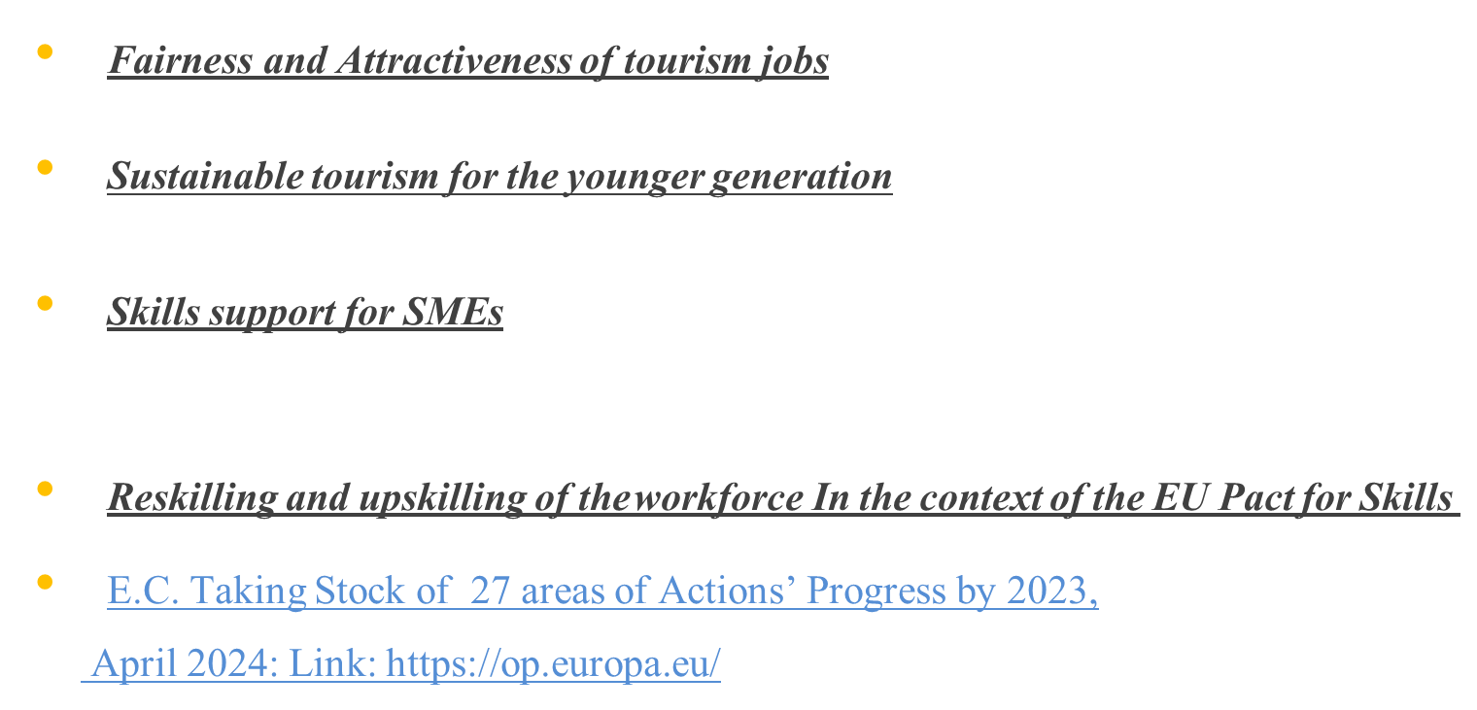
E.C. SWD 164 (2021) & EC COM Transition Pathway for Tourism 2/2022

Slide 4
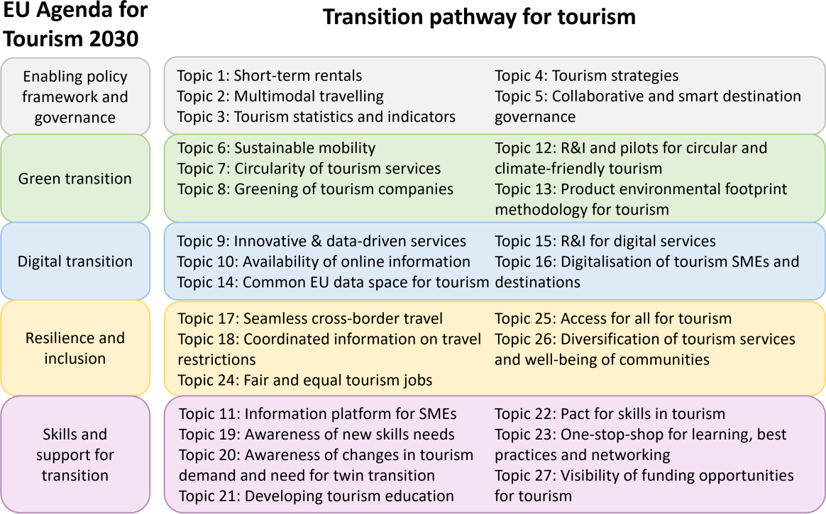

Slide 5
GREEN TRANSITION 1
Topic 6: Sustainable mobility
In October 2023, the Commission proposed a European declaration on cycling to boost bike use in the EU.
The proposed revision to the TEN-T Regulation proposes 424 major cities to develop SUMPs.
Topic 7: Circularity of tourism services
In July 2023, the Commission proposed a targeted amendment to the Waste Framework Directive (WFD). This proposal includes the objective for the Member States to reduce by December 2030 the generation of food waste per capita
The Fit for 55 legislative package also contributes to the energy efficiency and increased use of renewable energy across sectors, including tourism.
Open Call for expression of interest for new Smart Specialization (S3) partnerships to join the S3 Thematic
Platform on Sustainable Blue Economy. More info: Inforegio

Slide 6
GREEN TRANSITION 2
Topic 8: Green transition of tourism companies
The Commission supports the EU Eco-management and Audit Scheme (EMAS) for all economic sectors, including tourism
EU Ecolabel is a ‘best of class’ type of label which can be awarded to tourist accommodation services with excellent environmental performance.
Topic 12 R&I projects and pilots on circular and climate-friendly tourism
H2020/Horizon Europe had been given to 278 projects with links to tourism, sustainability, climate and circularity.
The EU Cluster collaboration platform includes 41 cluster organisations or initiatives dedicated to tourism
Topic 13: Product environmental footprint methodology
The Commission adopted a proposal for a directive on green claims in March 2023 highlighting the need to substantiate businesses’ environmental claims.

Slide 7
DIGITAL TRANSITION 1
Topic 9: Innovative and data-driven tourism services
The Enterprise Europe Network sector group on tourism (EEN SGT) is composed in 2023 of 84 members from 29 countries that regularly collaborate to support the tourism ecosystem actors in their territories.
Topic 10: Availability of online information on tourism offer
Commission supports national offices of the European Consumer Centre Network (ECCNet)
Topic 14: Common European data space for tourism
The European Data Governance Act became applicable on 21 September 2023.
Commission published in July 2023 a Communication on a common European data space for tourism.

Slide 8
DIGITAL TRANSITION 2
Topic 15: R&I for digital tools and services in tourism
In March 2022, the Commission launched 9 projects supported in total with EUR 9 million to enhance digital innovation in over 700 SMEs. The Commission also launched in 2022 the European Parliament pilot action on identifying and developing digital tools and solutions for the restaurant sector.
Topic 15: Digitalisation of tourism SMEs and destinations
With the support of the European Parliament, the Commission launched in 2023 a pilot project on EU Competence Centre for data management in tourism destinations (D3HUB).
Commission works towards the Digital Decade policy targets, such as 90% of all SMEs having at least basic digital intensity (using at least four technologies) and follows them through the DESI dashboard.

Slide 9

European Skills Agenda flagship initiative: large-scale skills partnerships across all ecosystems
14 Large-scale partnerships currently established in all ecosystems
Aim to upskill and reskill the European workforce in green, digital and social skills
Large-scale skills partnership (LSP) in tourism since January 2022
Support to the Pact for Skills in tourism through Erasmus+Pantour & in progress ERDF +ESF to ensure coordination over the next years
Currently over 128 members have submitted concrete action pledges with expected results
(EU umbrella associations, trade unions, higher education, regional authorities and clusters)
–open to all stakeholders of MS and IPA countries committed to the agreed objectives
All members of the Pact can benefit from three dedicated services:
Through the Networking Hub,
The Knowledge Hub
In the Guidance Hub

Slide 10
PACT FOR SKILLS IN TOURISM (TOPIC 22)
The Commission facilitated the establishment of the EU Pact for Skills partnership for the Tourism Ecosystem in 2022, with 80 signing members in 2023. The key targets for the large-scale skills partnership include the establishment of national and regional skills groups for upskilling and reskilling 10% of the tourism workforce each year from 2022 onwards
Topic 11 Information Platform for SMEs+Topic 23 One-stop-shop for learning, best practices and networking
In June 2023, the Commission launched the implementation of the stakeholder support platform for transition pathways, with the first implementation for tourism ecosystem. The platform is planned to be opened to the tourism stakeholder community in summer 2024.
Topic 27 : Visibility of funding opportunities for tourism
The Commission has drawn up and actively maintains the Guide on EU funding for tourism, summarising aspects of 17 EU funding programmes with potential to support tourism and giving examples of recently funded projects. Since 2022, the Guide includes a section called ‘Open tourism calls’
EU funding for Tourism: https://single-market-economy.ec.europa.eu/

Slide 11
Why does the EUSAIR Strategy need to be revised?
New challenges have emerged over the last decade and have risen up the new Programming agenda. These include EU enlargement, climate change, adaptation and decarbonisation, digitalisation, ecology, social inclusion, and rural development.
The main new points of the revised EUSAIR Action Plan of the Strategy to adapt to new challenges are:
A new, fifth thematic Pillar on ‘Improved Social Cohesion’ added.
Enlargement, horizontal topic in all Pillars.
Capacity building and multi-level governance better enshrined in the Strategy’s rationale.
Gender equality, youth involvement and EU fundamental rights mainstreamed in all pillars.
Climate change and the Green transition and dimension integrated across all Pillars.

Slide 12
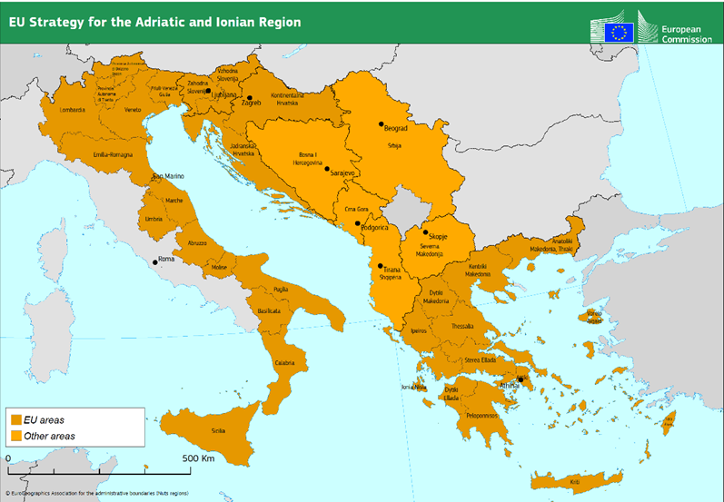
EUSAIR Sustainable Tourism-revisedTopics:
Facilitating Green and Digital Transition
Preparing for the future Knowledge, Skills and Management
Green Dimension

Slide 13
EUSAIR REVISION PROCESS next steps
E.C. Goals for EUSAIR Green Dimension: The EUSAIR region has several comparative advantages, such as a large part of rich in terms of biodiversity and sensitive environmental areas, high potential for quality food production, a large part of inland rural areas, a high contribution of tourism and food production to GDP per country, and high potential for distinction and sectoral interconnectivity in GREENING among Tourism, culture and food sector in the supply chains which can be transformed to competitive advantages enhancing the EUSAIR region’s economic, environmental and social sustainability
GREEN dimension in P4 with multifunctional Actions on Ecotourism, Agrotourism, fishing tourism including agri-food and gastronomy routes, Mediterranean diet, promotion of products of origin and bio-districts.
DG Regio is working with the DG Grow and the inline 10 DGs/EC to consolidate the revised EUSAIR Action Plan and Communication so that can be submitted to the formal Interservice consultation in June 2024 and be into force in Autumn 2024. Consultation with TSGs, DG Agri and Envi is also in progress

Slide 14

THE EU IS BUILT WITH Constructive Cooperation and Solidarity
Thank you for your contribution
Georgios EMMANOUIL / DG REGIO D1

