Slide 1

Padova 2030 – towards climate neutrality
Busitalia Veneto for sustainable mobility
18. April, 2023

Slide 2



FS Group, Busitalia and sustainability
The long-term objectives of the FS Group
SDGs
Long-Term Objective (2030-50)
Energy and emissions
To become carbon neutral until 2040, for both the energy purchased and self-produced by the FS Group - including energy for traction for rail and road transport and used for buildings and other structures (workshops, stations, offices, tunnels and roads).
Sustainable Mobility
5% increase of public, sustainable and shared mobility by 2030 compared to 2015 (15% by 2050). As for freight transport, the objective of the FS Group is to have 50% of goods moving by rail by 2050, on sections longer than 300km.
Safety
By 2050, bring to zero the number of fatal events among the people choosing to use the transport services offered by the FS Group, its employees and external contractors and providers.

Slide 3
Busitalia
Mission and company profile
Busitalia is the company and sub-holding of the Ferrovie dello Stato Italiane Group (FS), which task is the management of Local Transport Services on road and tramway.
The company structure is more complex, due to the existing partnerships with other operators, to manage transport services within the regions of Toscana and Umbria.
Busitalia - Sita Nord
Qbuzz & subsidiaries
Qbuzz Mobility Services
Busitalia Veneto
ATAF Gestioni
Busitalia Campania
Busitalia Rail Service
Savit
100%
55%
78,9%
70%
100%
100%
100%
Main activities
Firenze City Sightseeing
PT
Toscana
60%
Market services
I-MAGO
Maintenance services
58%

Slide 4








Busitalia
Public Transport Italy – KPI actual borders
Distance covered (bus*km)
103 mln (82 mln of which PT)
Passengers PT
105 mln (pre-COVID 220 mln)
Padova
Rovigo
Fleet (n.)
1.700
Perugia
Employees
2.800
Terni
Value of the service produced
300 mln di €
Salerno

Slide 5
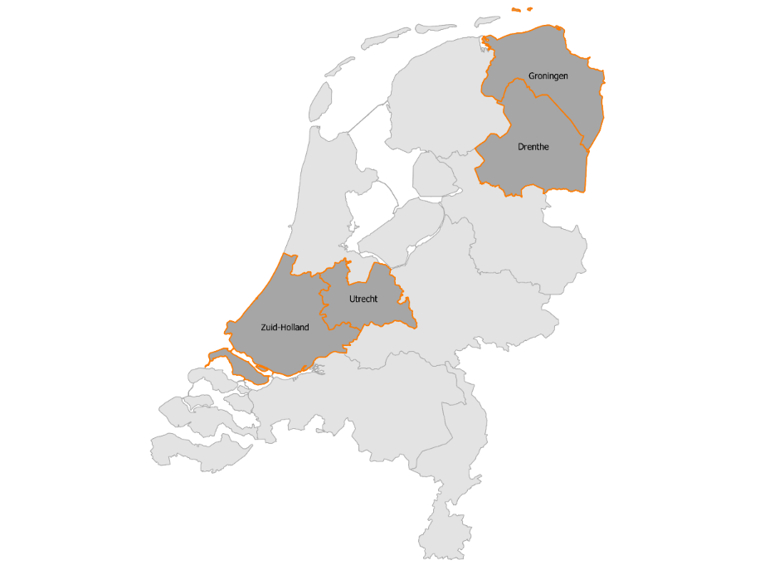
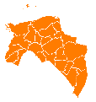
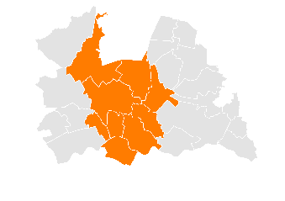

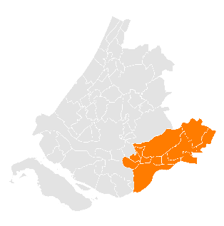

Busitalia
TPL Netherlands– KPI actual borders (2021)
Distance covered (bus*km)
70 mln
UTRECHT
Passengers PT
48 mln (pre-COVID 80 mln)
Fleet (n.)
940
Employees
2.400
GRONIGEN-DRENTHE
Value of the service produced
295 mln di €
DMG

Slide 6
Busitalia Veneto
KPI 2022
Distance covered (bus*km)
27,9 mln
Passengers PT
26 mln
Fleet (n.)
670
Employees
880
Padova
Rovigo
Value of the service produced
88 mln di €

Slide 7
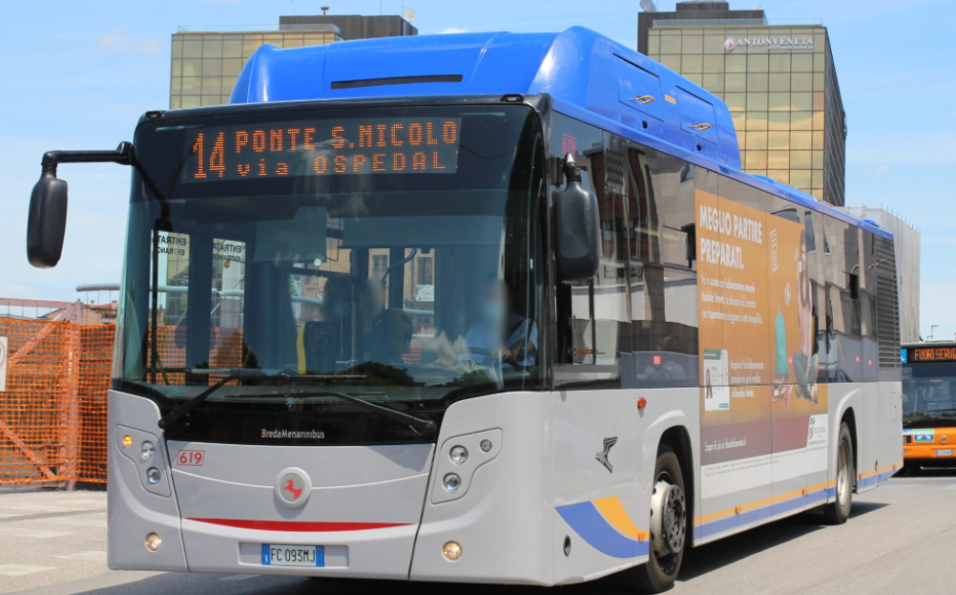
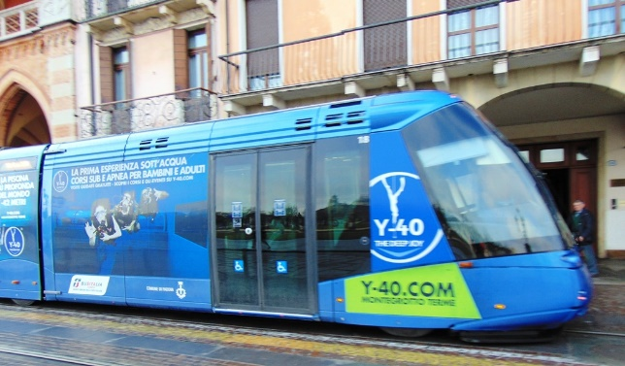
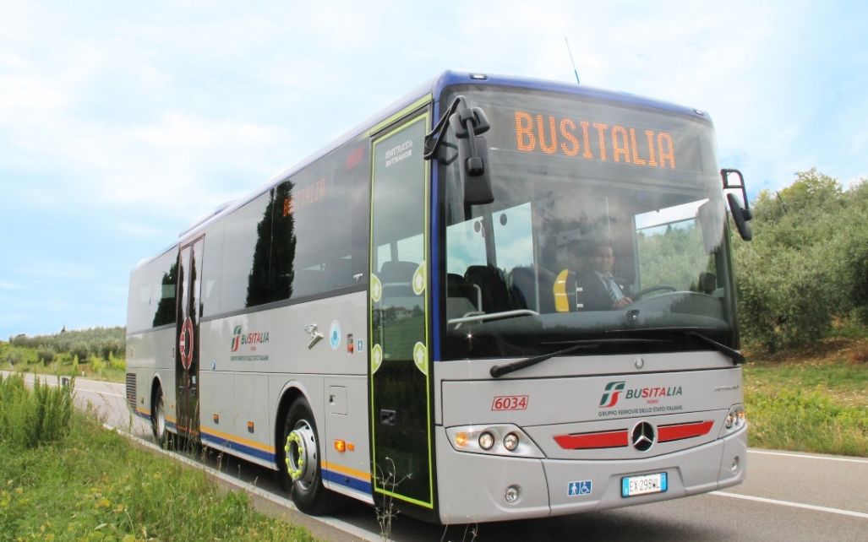

Busitalia Veneto
Public Transport in Padova
Urban Public Transport – Bus & Tram
Regional service
2022
15,2 mln bus*km covered
6,5 mln bus*km covered
860.000 tram*km covered
187 mln passengers* km

Slide 8
Sustainability for Padova

Slide 9



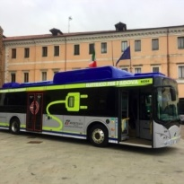

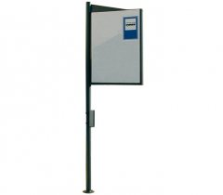
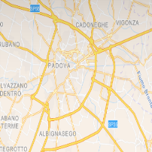

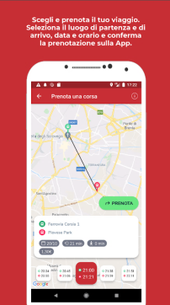

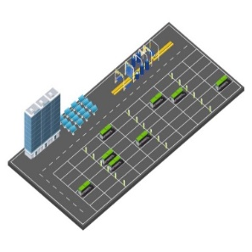
Ongoing activities
Our commitment for sustainable mobility
New Electric and Euro6 fleet replacing the oldest and natural gas vehicles
Ensuring a safe collective transport
Improving air quality
Costantly improving environmental performances
Fleet renovation
273 e-ink poles powered by solar energy and 93 led-displays
Making cities more inclusive, resilient and sustainable
Real-time info e-displays at bus stops
Making cities more inclusive, resilient and sustainable
e-ticketing
App Busitalia Veneto, webshop, EMV
Making cities more inclusive, resilient and sustainable
Listening to the communities
Demand responsive service
QUIBUS
Ongoing design for 2 green depots for the electric bus fleet: Goldoni e Pescarotto (PD).
Developing quality infrastructure
Improving air quality
Costantly improving environmental performances
Green depots

Slide 10
Funding distribution – BUSITALIA VENETO
Area of Padua
Funding availability | T | Total funding (C+D) | Bus funding (C) | Infrastructure funding (D) | Nr. buses | Bus type | Bus unit cost | BIV bus cost | Progress | Expiry date
PSNMS «Polluted towns» | U | € 10.667.298 | € 9.344.798 | € 1.322.500 | 20 | Electric | € 467.240 | € 934.480 | Ready to order | 2025 for buses; 2027 for IF
PSNMS «Towns with more than 100k Residents» | U | € 20.574.433 | € 16.020.000 | € 4.554.433 | 40 | Electric | € 400.500 | € 4.050.000 | Ready to order | Still unknown
PSNMS "Regions" | I | Still Unknown | - | - | - | - | - | - | - | Still unknown
Additional funds PSNMS | I | € 5.358.014 | € 5.358.014 | 0 | 12 | Electric | € 446.501 | 0 | Ready to order | within end of 2023Nationa
RRF | U | € 10.232.127 | € 8.160.000 | € 2.072.127 | 16 | Electric | € 400.500 | 0 | Ready to order | 4 buses within end of 2024; 16 buses in total within 2026
TOTAL |  | € 46.831.872 | € 30.722.812 | € 7.949.060 | 72 |  |  | € 4.984.480
*PSNMS: National Strategic Plan for Sustainable Mobility
*RRF: Recovery and Resilience Plan

Slide 11
Funding distribution – BUSITALIA VENETO
Area of Rovigo
Funding availability | T | Total funding (C+D) | Bus funding (C) | Infrastructure funding (D) | Nr. buses | Bus type | Bus unit cost | BIV bus cost | IF BIV cost | Progress | Expiry date
PSNMS «Polluted towns» | U | € 6.211.185 | € 5.436.685 | € 774.500 | 11 | Electric | € 494.244 | € 743.315 | € 0 | 12 m ready to order; 9 m to be done | 2025 for buses; 2027 for IF
PSNMS "Regions" | I | Still Unknown |  |  |  |  |  |  |  |  | Still unknown
Additional funds PSNMS | I | € 2.460.510 | € 2.460.510 | 0 | 6 | Electric | € 410.085 | € 0 | 0 | Ready to order | within end of 2023
RRF | U | € 5.958.964 | € 4.080.000 | € 1.878.964 | 6 | Electric | € 680.000 | 0 | 0 | Ready to order | 2 buses within end of 2024; 8 buses in total within 2026
 |  | € 14.630.659 | € 7.897.195 | € 2.653.464 | 17
 |  | IF cost | Funding | BIV cost for IF
Pescarotto depot |  | € 1.923.057 | € 576.917* | € 1.346.140
Goldoni depot |  | ? | € 7.949.060 | ?
Petrarca depot (Rovigo) |  | € 3.299.235,25 | € 2.653.464 | € 645.771
 |  |  |  | € 1.991.911
*Request submitted to CEF AFIF

Slide 12
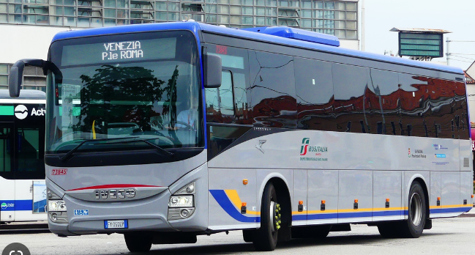
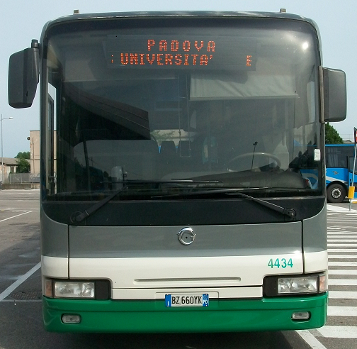
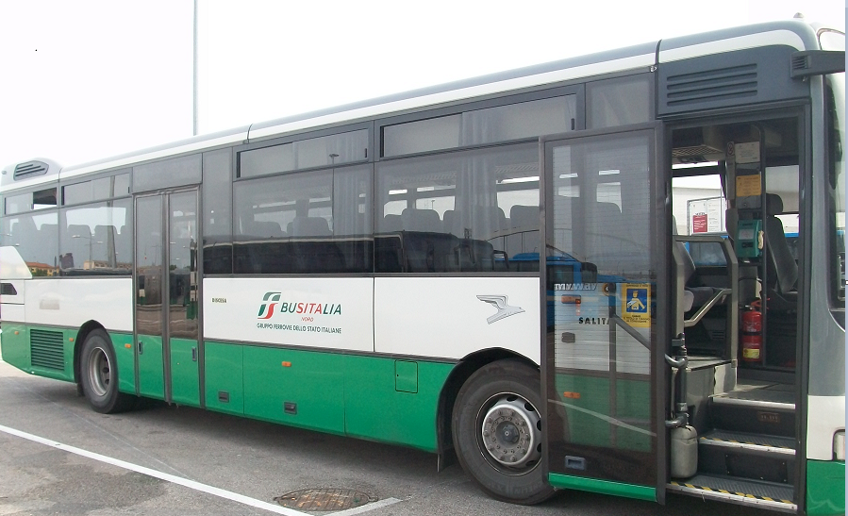
Ongoing activities
Riduction of CO2 emissions: fleet renovation
IN
OUT
53 buses (35 Euro 6 e 18 Electric buses)
13 buses Euro 6
55 buses Euro 2,3,4,EEV
23 buses Euro 2,3
2023
Padova:
12 electric buses, 3 hybrid urban buses, 10 natural gas urban buses, 15 regional diesel buses
Rovigo:
6 electric buses, 1 hybrid urban bus, 1 natural gas urban bus, 5 regional diesel buses
2022
Padova:
7 urban buses + 3 regional short-distance buses +1 regional bus
Rovigo:
1 electric bus + 1 regional diesel bus
2023
2022
Buses mainly Euro 2 and 3
Padova: 22 urban and regional diesel buses
Rovigo: 1 diesel urban Euro2 bus

Slide 13
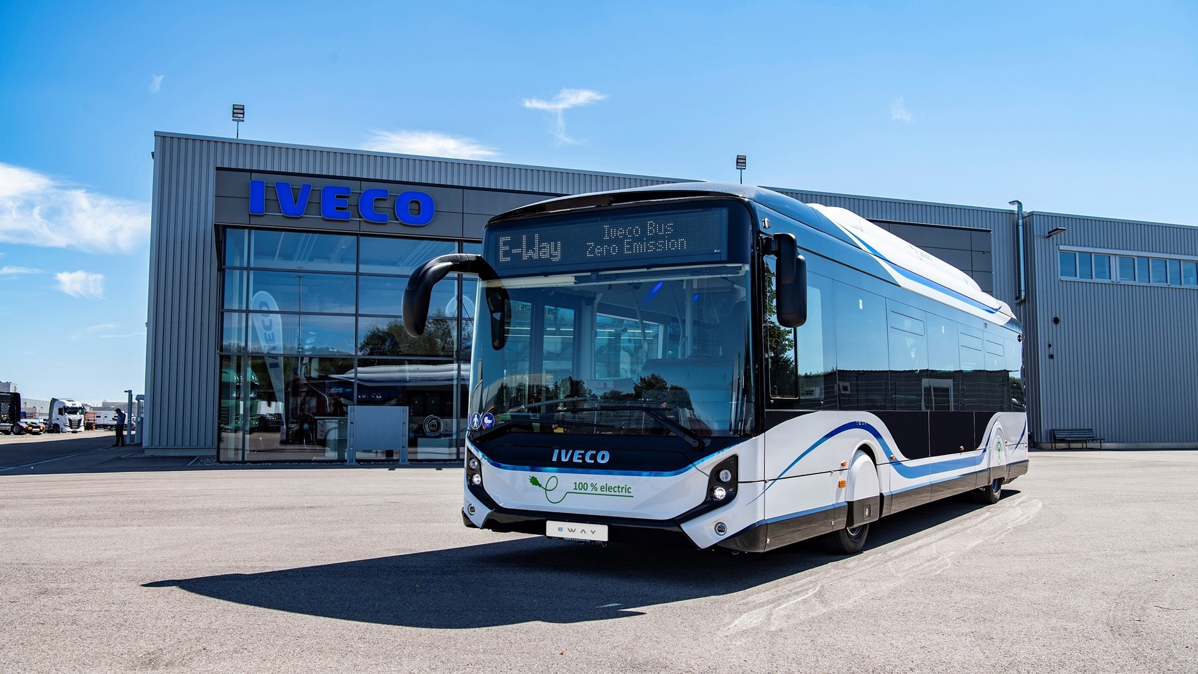
Ongoing activities
Ensuring a safe collective transport
Improving air quality
Costantly improving environmental performances
Fleet renovation: Electric buses
NEW IN - 2023
Electric buses in Padova:
460 KW batteries;
320 km average range;
Overnight recharge
12 buses in 2023
In 2024, total fleet: 120 buses
7 electric buses already in operation
- 5.000 CO₂
Compared to 2019

Slide 14
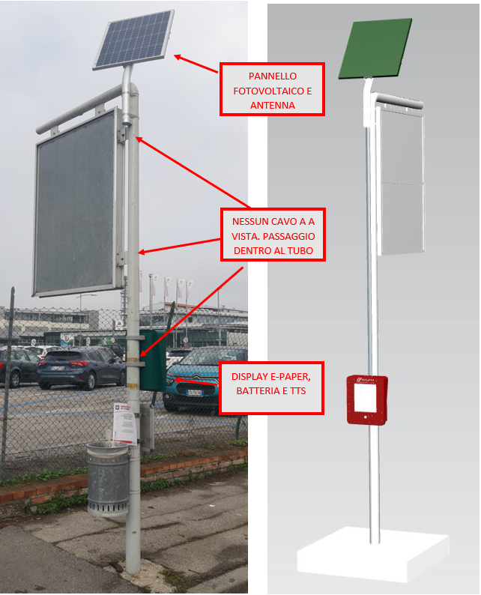
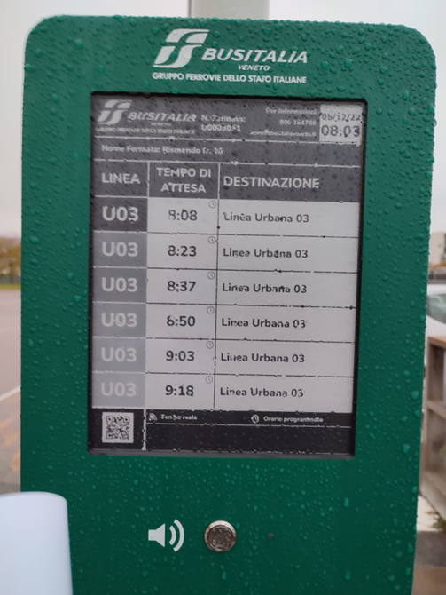
Ongoing activities
Making cities more inclusive, resilient and sustainable
Real-time info e-displays at bus stops powered by solar panels
Busitalia Veneto has started a deployement plan of 273 e-ink poles powered by photovoltaic panels;
Solar panels can be oriented during installation;
GPS for localization, connection through Data SIM card 1GB/mo;
e-paper 13’’ display TTS button into Italian for visually impaired people;
12V internal battery;
48 additional led-displays have been installed at bus stops and 45 more at tram stops.

Slide 15
Ongoing activities
Making cities more inclusive, resilient and sustainable
E-ticketing: app, webshop and EMV
Busitalia Veneto, in 2019, has started e-ticketing services with own app.
In 2021 Busitalia Veneto has activated contactless payments with credit card on the tram line called SIR1
Purchase of tickets through the internet (app, webshop and EMV), in the first 2 months of 2023 has reached 16% of all tickets purchased.
This trend allows reducing the use of paper for printed tickets and passes, but also broadens the accessibility to tickets as well as information on the transport service.

Slide 16
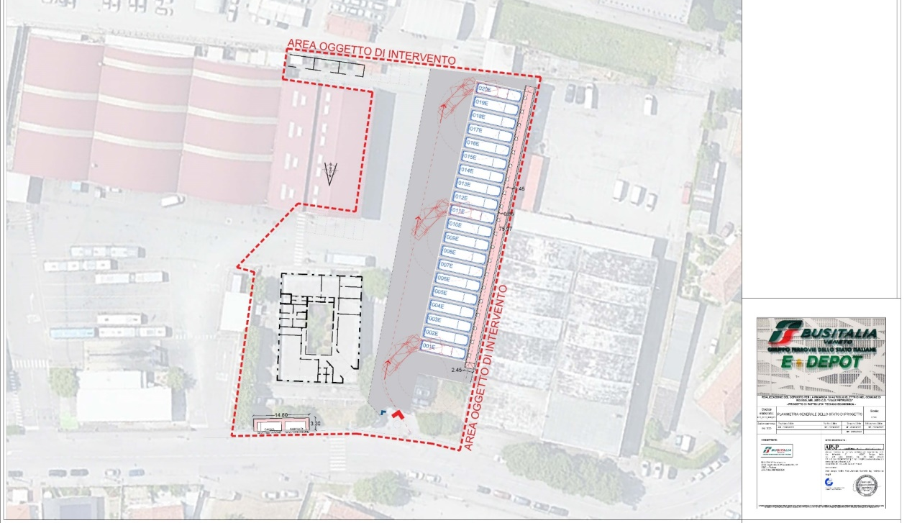
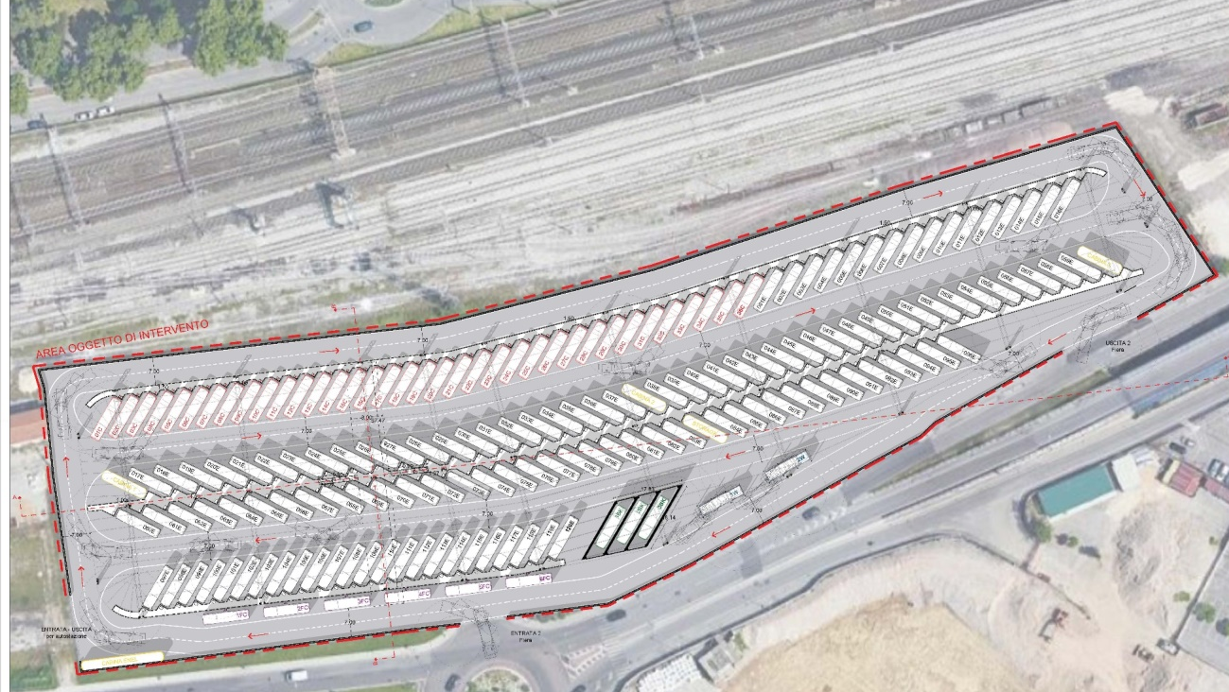
Ongoing activities
Developing quality infrastructure
Improving air quality
Costantly improving environmental performances
Design of new bus depots for Padova Pescarotto and Padova Goldoni
Depot via del Pescarotto
Depot Goldoni
12 e-charging points;
overnight recharging
*Request for cofinancing of 576.918,00€ has been submitted to CEF AFIF
90 e-charging points
overnight recharging

Slide 17
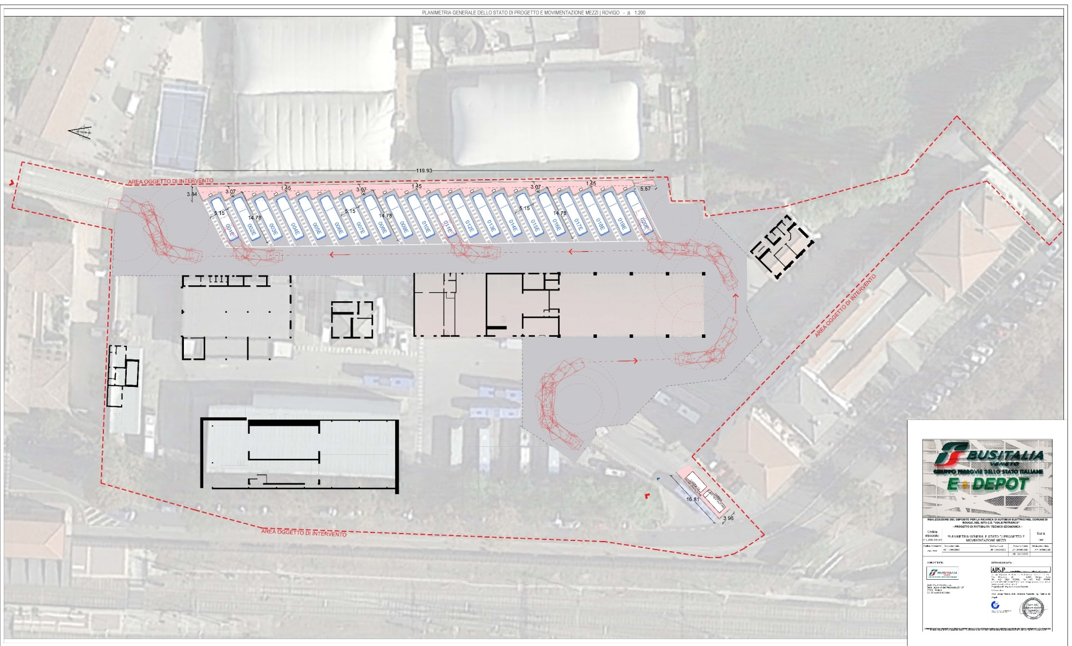
Ongoing activities
Design of a new bus depot in Rovigo
Equipment of the depot for e-buses
Depot of Rovigo:
6 e-charging points in the first phase;
30 e-charging points once completed;
Overnight recharging
1 e-bus in 2022
6 e-buses in 2023
Total e-buses when completed: 30

Slide 18
Main objectives
Sustainability plan – levels of ambition
Busitalia project | FS Group objective | indicator 2030
Fleet renovation plan | Co2 emissions reduction Phase out of fossil fuels for traction | -4% CO2
 | Fossil fuel reduction Phase out of fossil fuels for traction
 |  | -30%
Purchase 100% of energy from GO | Purchase of energy with guarantee of origin | 100% other uses 100% traction
New green depot for e-buses in Padova | Self production of energy from renewable sources not for traction | 4%
Digitalization, health safety, security, safety, new buses, quality of services, intermodality | Modal Shift from the privately owned car to a shared, public and sustainable mobility | 5 % vs 2015
External providers selected according to the ESG framework and regularly monitored | Sustainable Supply Chain Management. Monitoring and improvement of the ESG profile of external providers. New procedure for circular procurement | 100%

Slide 19
Thank you for your attention
Aldo Paribelli
Chief Operating Officer - Busitalia Veneto SpA a.paribelli@fsbusitaliaveneto.it cell +39 3356520696

