Slide 1


Sustainable tourism and mobility: case study of Lefkas
By Marina Kouta – May 25, 2023

Slide 2
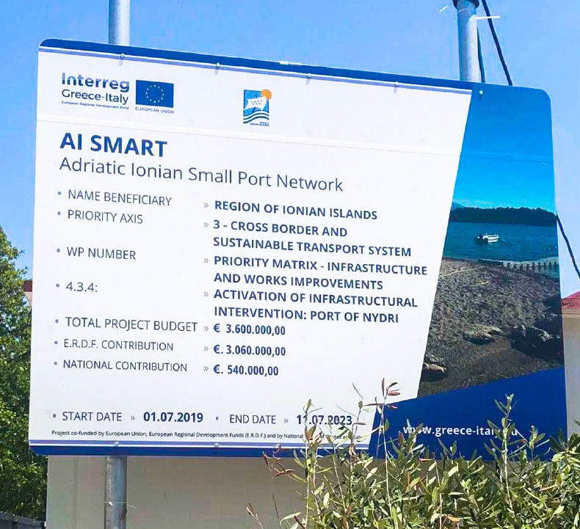
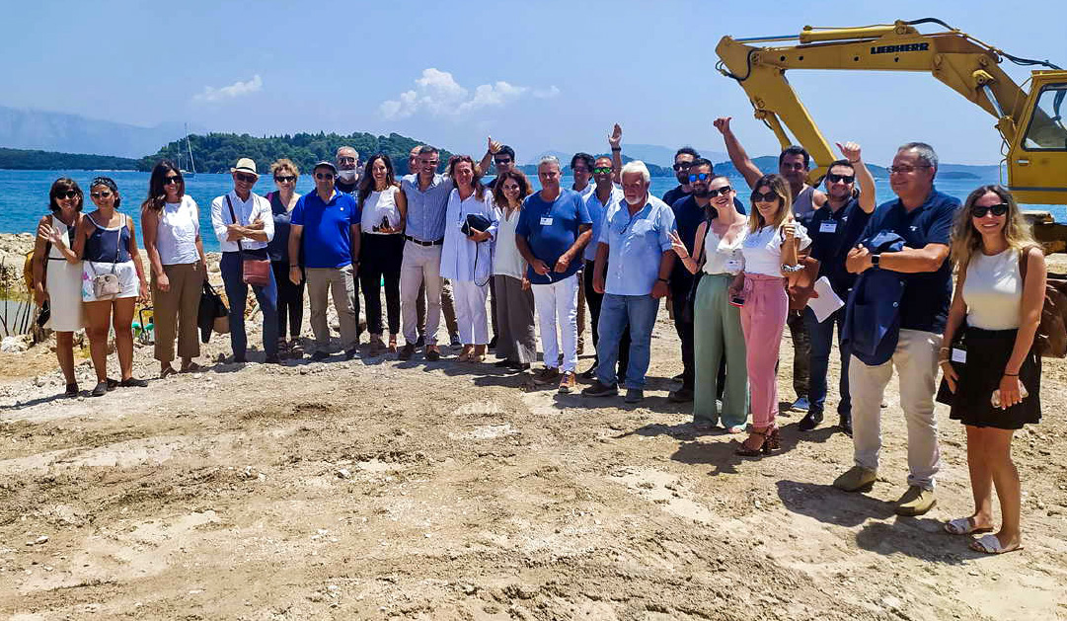
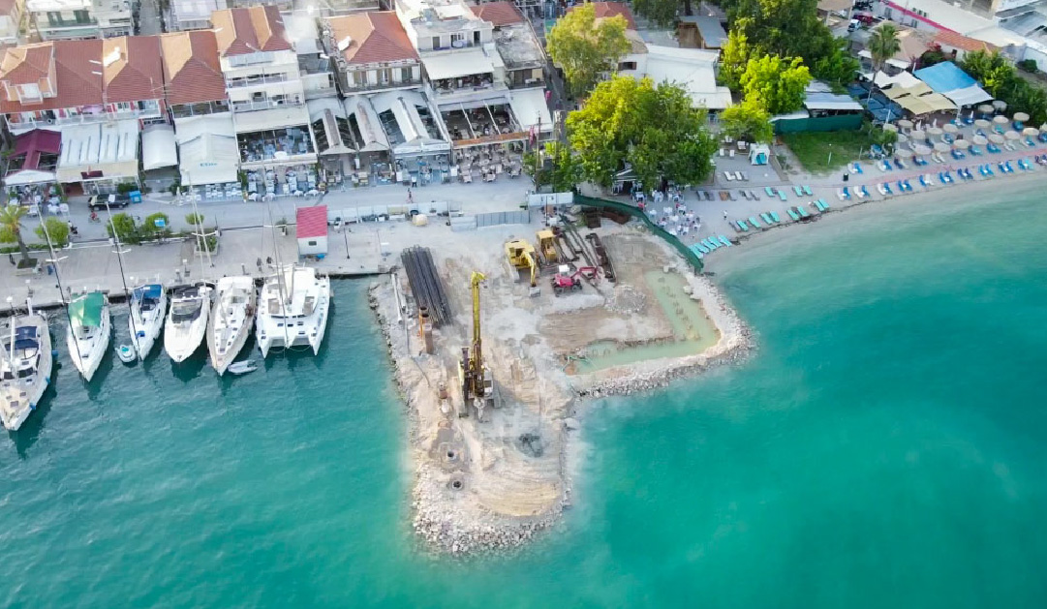
01
Common port network in the Adriatic-Ionian area
AI Smart - Adriatic Ionian SMAll PoRT Network
02
Concept of "Smart, Green and Integrated ports"

Slide 3
Key Aspects
Touristic Ports/Marinas
Safety and professionalism
Easy access and use of information
Easy access and transport connections
Environmental protection and cleanliness
Price value

Slide 4
Sustainable Marina
Concept
Integration of an EMS and
smart systems
(cost savings and improved management control)
Improved
Environmental
Performance & Monitoring
Mobilizing and
training of
personnel
Compliance
with legislation
Engaging local
Community & meeting costumer’s expectations

Slide 5
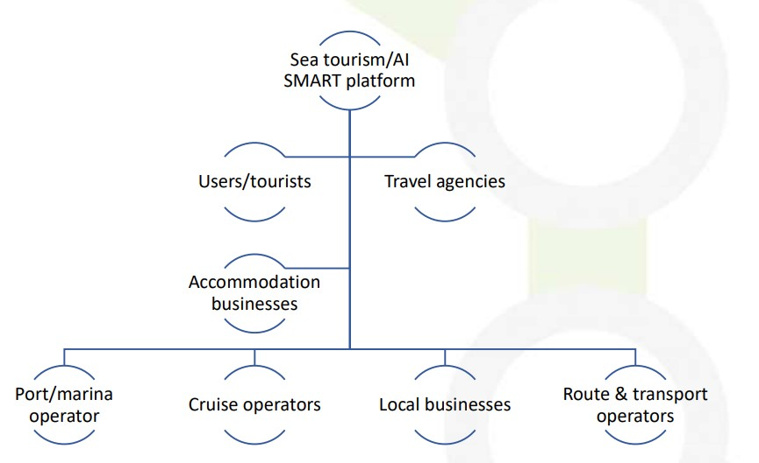
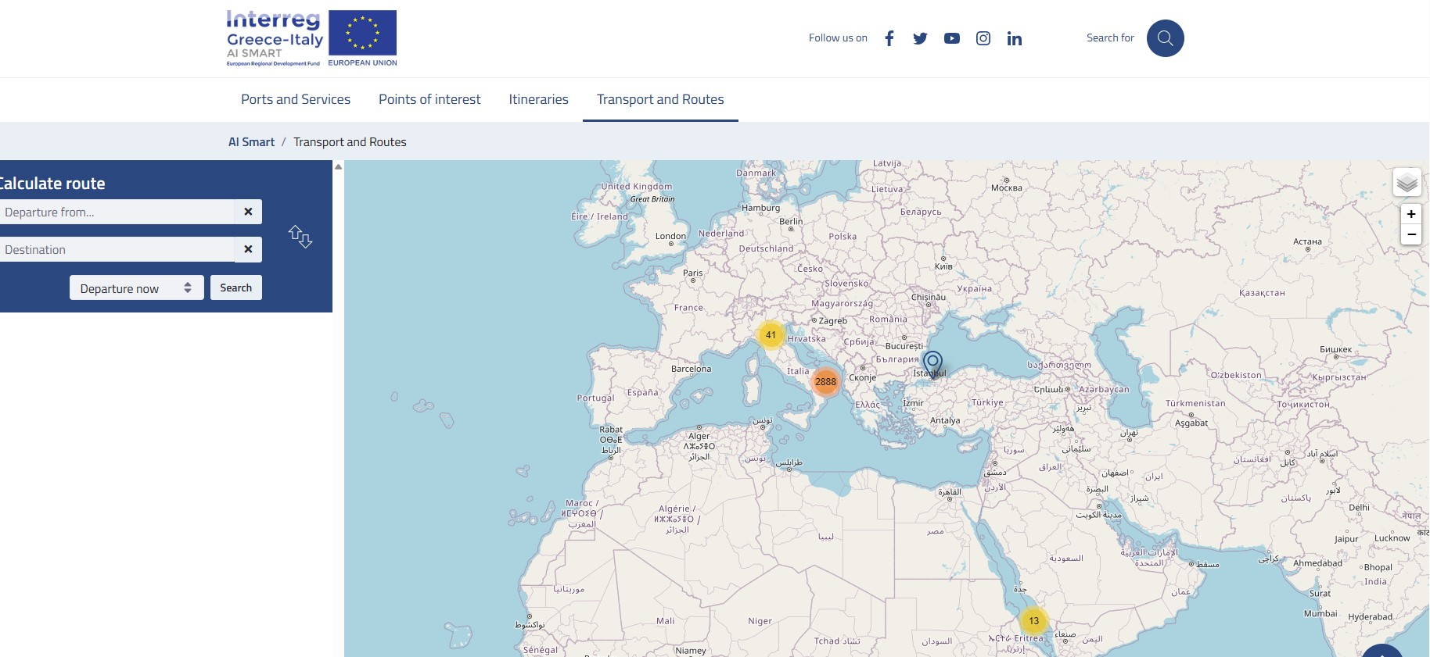
The uses of the platform differ Based on the distinct category of the actor!
Services for Stakeholders
Platform

Slide 6
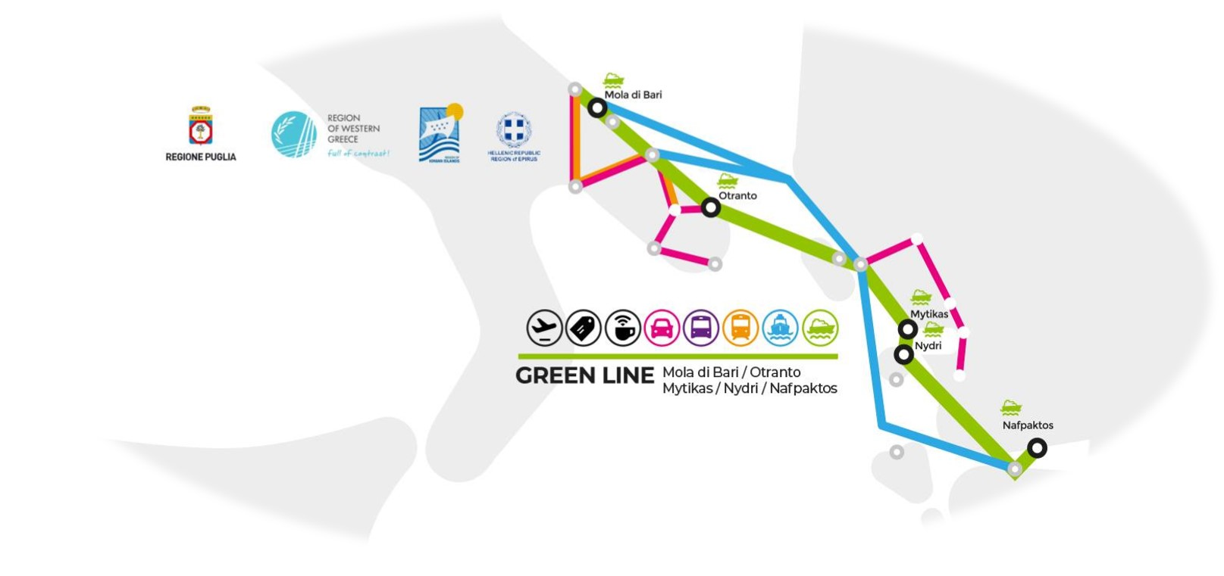
Research
1
The goal of the methodology is to allow a homogeneous and objective classification (9 classes).
The methodology and provides an operational tool for stakeholders, considering:
Accessibility port requirements
Marine capacity port requirements
Reclassification is a tool that can support the definition of the strategy that each harbor planner can apply based on previously established scenarios.
Classification

Slide 7
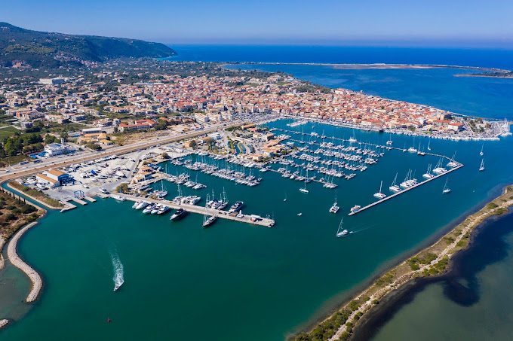
Potential and Action
2
"Blue Flag" Program 2022 awarded marina.
Lefkas Marina, possibly one of the most modern marinas of the Mediterranean, has been operating since 2002.
Lefkas Marina has mooring places for 620 boats up to 45 meters long. It offers a full range of technical boat services.
Cooperation with Region of Ionian Islands
We intend to highlight Lefkada as an example of multimodal transportation for sustainable island tourism and candidate for Green Living Are.
Lefkas Marina

Slide 8


C-Roads - The Platform of Harmonised
C-ITS Deployment in Europe
1
European Member States & Road
Operators
- Testing and Implementing
C-ITS services
- Detection, respond and damping
2
GIFT 2.0
- End-user-oriented services for routes
planning and adaptive routes
- ITS use

Slide 9
Framework:
Green Living Mobility Systems
Personalised multimodal mobility information.
Personalised mobility services (e. g. Mobility as a Service, shared mobility, parking booking).
Multimodal mobility info
A
E-vehicles, e-bicycles, e-tricycles, e-scooters
Soft Mobility
B
Policies to increase area friendliness
Policies to increase inclusiveness
Policies
C
Promotion of public transport, active mobility and optimisation of individual cars.
Public transport
D

Slide 10
Monitor & Dialogue
Cooperation is key to sustainable urban development and the effective management of Green Living Areas
Performance measures help decision-makers assess how transportation policies and investments contribute to achieving regional goals.
For mobility, such indicators could be the number of micro mobility vehicles (e.g., bicycles, e-bicycles, e-scooters) per capita, traffic calming policies, e-mobility/micro mobility existing policies, etc.)

Slide 11

THANK YOU
Marina Kouta
Senior Project Manager & Researcher
University of Patras
marina.kouta@g.upatras.gr

