Slide 1

Educated and skilled workforce for sustainable tourism as addressed by the Hellenic Ministry of Tourism.
Dimitra Vasilopoulou
Directorate of Tourism Education and Training, Ministry of Tourism
GREECE

Slide 2

Ministry of Tourism, Greece
DIRECTORATE OF TOURISM EDUCATION AND TRAINING
emphasis on tourism education and vocational training
operational objective: design and implementation of educational policies and training actions aimed at upgrading tourism services provided
Education provided covers a wide spectrum:
a. Higher Education (ASTE), b. Post-Secondary Vocational Training (Tourism Vocational Training Institutes), c. Tourist Guides’ Training, d. Continuous Vocational Training
free attendance for all students
include paid placement-apprenticeship in selected hotels and tourism enterprises (on – the - job training)

Slide 3
Ministry of Tourism, Greece
HIGHER EDUCATION
2 Advanced Schools of Tourism Education (ASTE) in Rhodes and Crete
Admittance via National Examinations
8 academic semesters (2 terms/year) and 3 trimesters of paid placement during summer, supervised closely by the Ministry
European Qualification Framework Level 5

Slide 4
Ministry of Tourism, Greece
POST-SECONDARY VOCATIONAL TRAINING
8 Tourism Vocational Training Institutes (TVTI) across the whole country
Admittance via a procedure supervised by the Ministry of Tourism
Specializations: Executive in Hospitality Units, Tourism Administration Executive, Technician in Culinary Art (chef), Baker-Technician in Pastry Art, Executive in Travel and Tourism Business *, Executive in Hospitality Operations – Rooms Division Specialization *
4 academic semesters (2 terms/year) and 2 semesters of paid placement, supervised closely by the Ministry
European Qualification Framework Level 5

Slide 5
Ministry of Tourism, Greece
TOURIST GUIDES’ TRAINING
5 Schools for Tourist Guides: Athens (Attica), Thessaloniki (Macedonia), Rhodes (South Aegean), Rethymno (Crete) and Corfu (Ionian Islands)
Admittance via a procedure supervised by the Ministry of Tourism
2 academic years (theoretical classes and educational visits and trips to important museums and archaeological sites)

Slide 6
Ministry of Tourism, Greece
CONTINUOUS VOCATIONAL TRAINING
Vocational training programmes for unqualified employees and temporarily unemployed professionals who have only empirical knowledge on the field
Several cities in Greece, depending on local market’s needs
Admittance via a procedure supervised by the Ministry of Tourism
380 hours of attendance
Aims: enrich skills, develop specialized personnel and upgrade the level of offered services in Greece’s tourism industry

Slide 7
Ministry of Tourism, Greece
CURRENT DEVELOPMENT –
NATIONAL RECOVERY AND RESILIENCE PLAN “GREECE 2.0” (1/4)
The Ministry has designed and plans to implement upskilling and reskilling training programmes
Its main purpose is to equip the workforce of any age with the skills needed in the labor market as well as with skills in line with the green and digital transition of the EU, by means of brief training programmes
Addressed to specific categories of workers and unemployed in the tourism sector: a) seasonal workers, b) long-term unemployed and c) employees whose employment contract was suspended in 2020 and 2021 due to COVID-19 implication on businesses’ operation.

Slide 8
Ministry of Tourism, Greece
CURRENT DEVELOPMENT –
NATIONAL RECOVERY AND RESILIENCE PLAN “GREECE 2.0” (2/4)
-Project objective: The upskilling and reskilling of the human resources of the tourism sector stand as the necessary condition for the implementation of policies and measures that will facilitate the sector's growth model transformation, contributing in parallel to better shape the image of the industry in the post COVID-19 era
-The Ministry of Tourism has designed and plans to implement upskilling and reskilling training programmes. Their purpose is to equip the workforce of any age with the skills needed in the labour market as well as with skills in line with the green and digital transition of the EU, by means of brief training programmes.

Slide 9
Ministry of Tourism, Greece
CURRENT DEVELOPMENT –
NATIONAL RECOVERY AND RESILIENCE PLAN “GREECE 2.0” (3/4)
Said training programmes’ characteristics:
1. Addressed to specific categories of workers and unemployed in the tourism sector: a) seasonal workers, b) long-term unemployed and c) employees whose employment contract was suspended in 2020 and 2021 due to COVID-19 implication on businesses’ operation.
2. Targeted at least 18,000 beneficiaries
3. Use of asynchronous technological tools
4. Offer an educational allowance to each trainee (250 euros)
5. Implemented through four (4) cycles, first one of which is expected to start towards the end of the year.

Slide 10

Ministry of Tourism, Greece
CURRENT DEVELOPMENT –
NATIONAL RECOVERY AND RESILIENCE PLAN “GREECE 2.0” (4/4)
Specializations offered cover a significant part of the services
provided by the Greek tourism product:
Front Office services and digital skills
Food and Beverage Management - food hygiene and safety
Culinary and pastry art
Housekeeping and environmental management
Outdoor Recreational Activities
Bath/Thalassotherapy Services – SPA
Executive of Tourist Offices

Slide 11
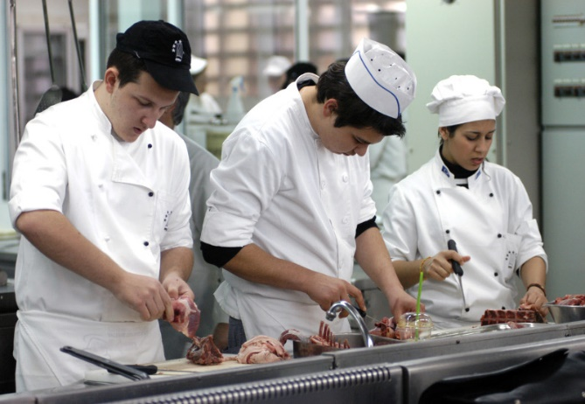

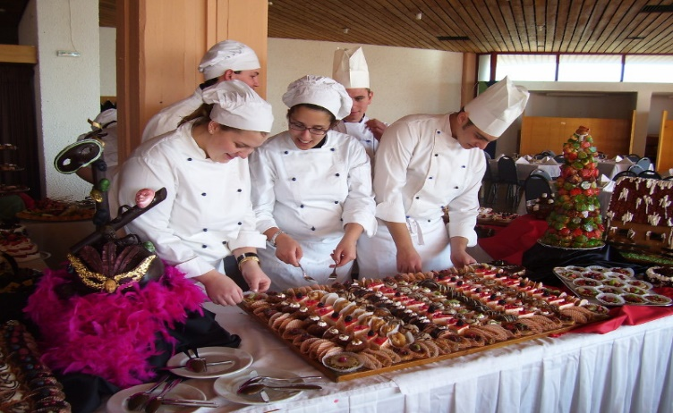

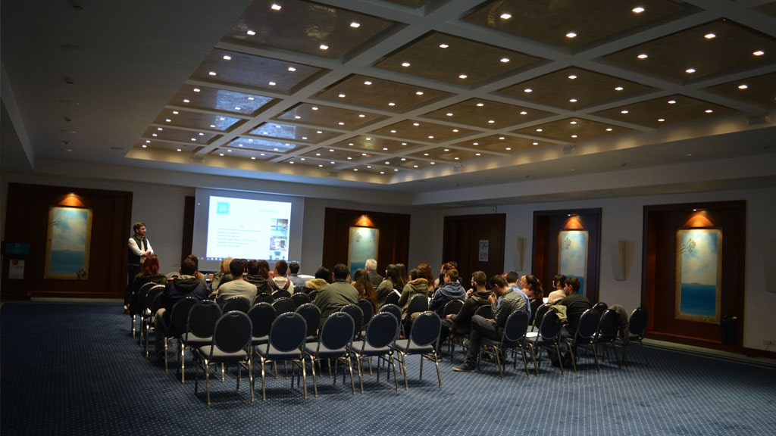


Ministry of Tourism
Learn from the experts!

Slide 12
Thank you for your attention! Dimitra Vasilopoulou Directorate of Tourism Education and Training, Ministry of Tourism GREECE

