Slide 1


Road Map towards a EUSAIR Power Exchange and Natural Gas Trading Hub for the Adriatic and Ionian Region Outlook and Proposals
8th EUSAIR Annual Forum
Sarajevo
24/05/2023

Slide 2
Objectives of the project
Roadmap for the integration of energy markets in the Adriatic-Ionian region
Distance from the EU target model for the electricity & gas sectors
SI
HR
IT
Activities necessary to close the gap
BA
RS
ME
MK
AL
Roadmap for implementation
GR

Slide 3
Agenda
1 | Fundamentals of the electricity and gas sectors in the Adriatic-Ionian region
2 | Current status of market development in the Adriatic-Ionian region
3 | Actions needed to integrate energy markets in the Adriatic-Ionian region

Slide 4
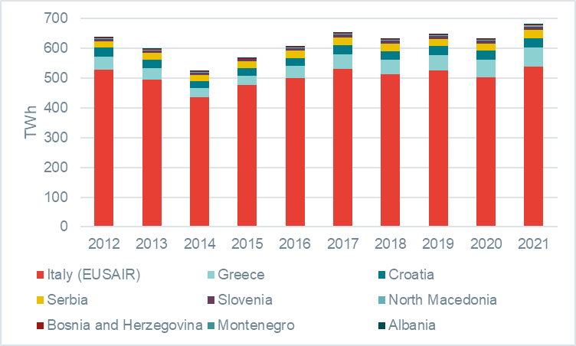
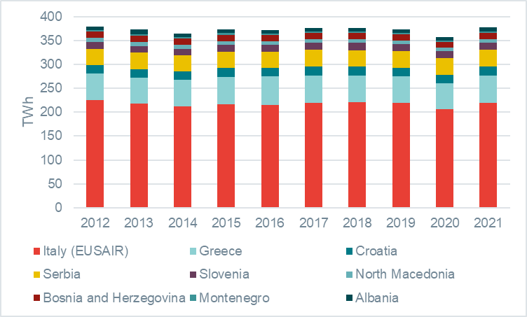
Fundamentals of the electricity and gas sectors in the region
Natural gas consumption by country
Source: Eurostat
Electricity consumption by country
Source: Eurostat
Natural gas map
Source: ENTSO-G
Different market sizes, with larger markets already compliant with the
EU policy framework and well-integrated with the rest of the EU block

Slide 5
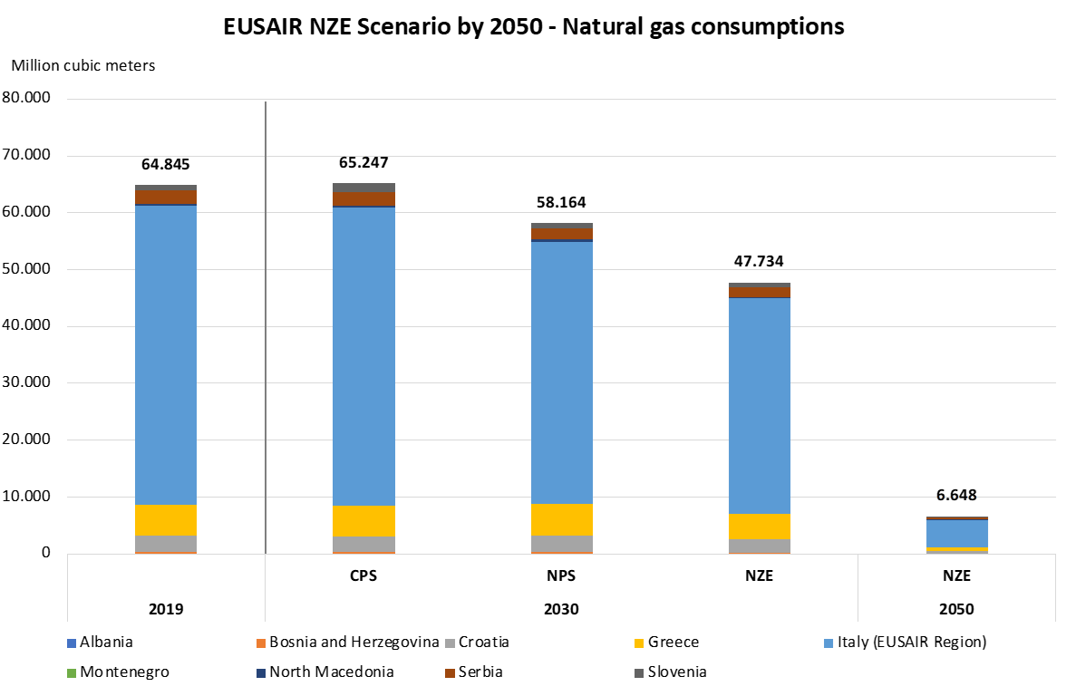
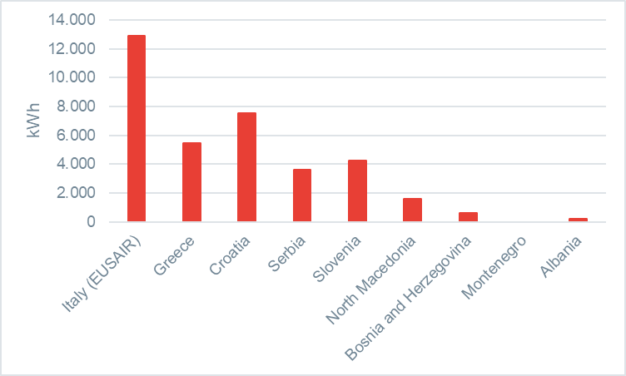
The evolution of the gas sector is in the hands of national authorities
Natural gas consumption per capita
Natural gas consumption scenarios
Source: Eurostat
Source: Analysis by Nomisma Energia

Slide 6
The gas network
Existing pipeline
Intra-EUSAIR points
Northern Europe
Russia
Pipeline (import)
Planned pipeline
TAG
Pipeline (bidirectional)
Planned/under construction LNG
Pipeline (export)
TRANSITGAS
Planned/under construction point
LNG (operational)
BALKAN STREAM
UGS (operational)
Planned UGS
Russia
TURKSTREAM
IAP
TAP
TAP exp.
Azerbaijan
TANAP
EASTMED
TRANSMED
GREENSTREAM
Northern Africa
Israel (via Cyprus)
Notes:
There is no evidence of structural congestions so far, but some countries are less connected than others due to their limited size and geographical position (inner ex-Yugoslavian countries such as Bosnia & Herzegovina and Montenegro). In particular, Bosnia & Herzegovina is currently connected only via Serbia
New developments (such as the Ionian-Adriatic Pipeline, IAP) would increase the degree of integration, and could foster the development of the gas sector where this is currently absent (Albania, Montenegro)

Slide 7
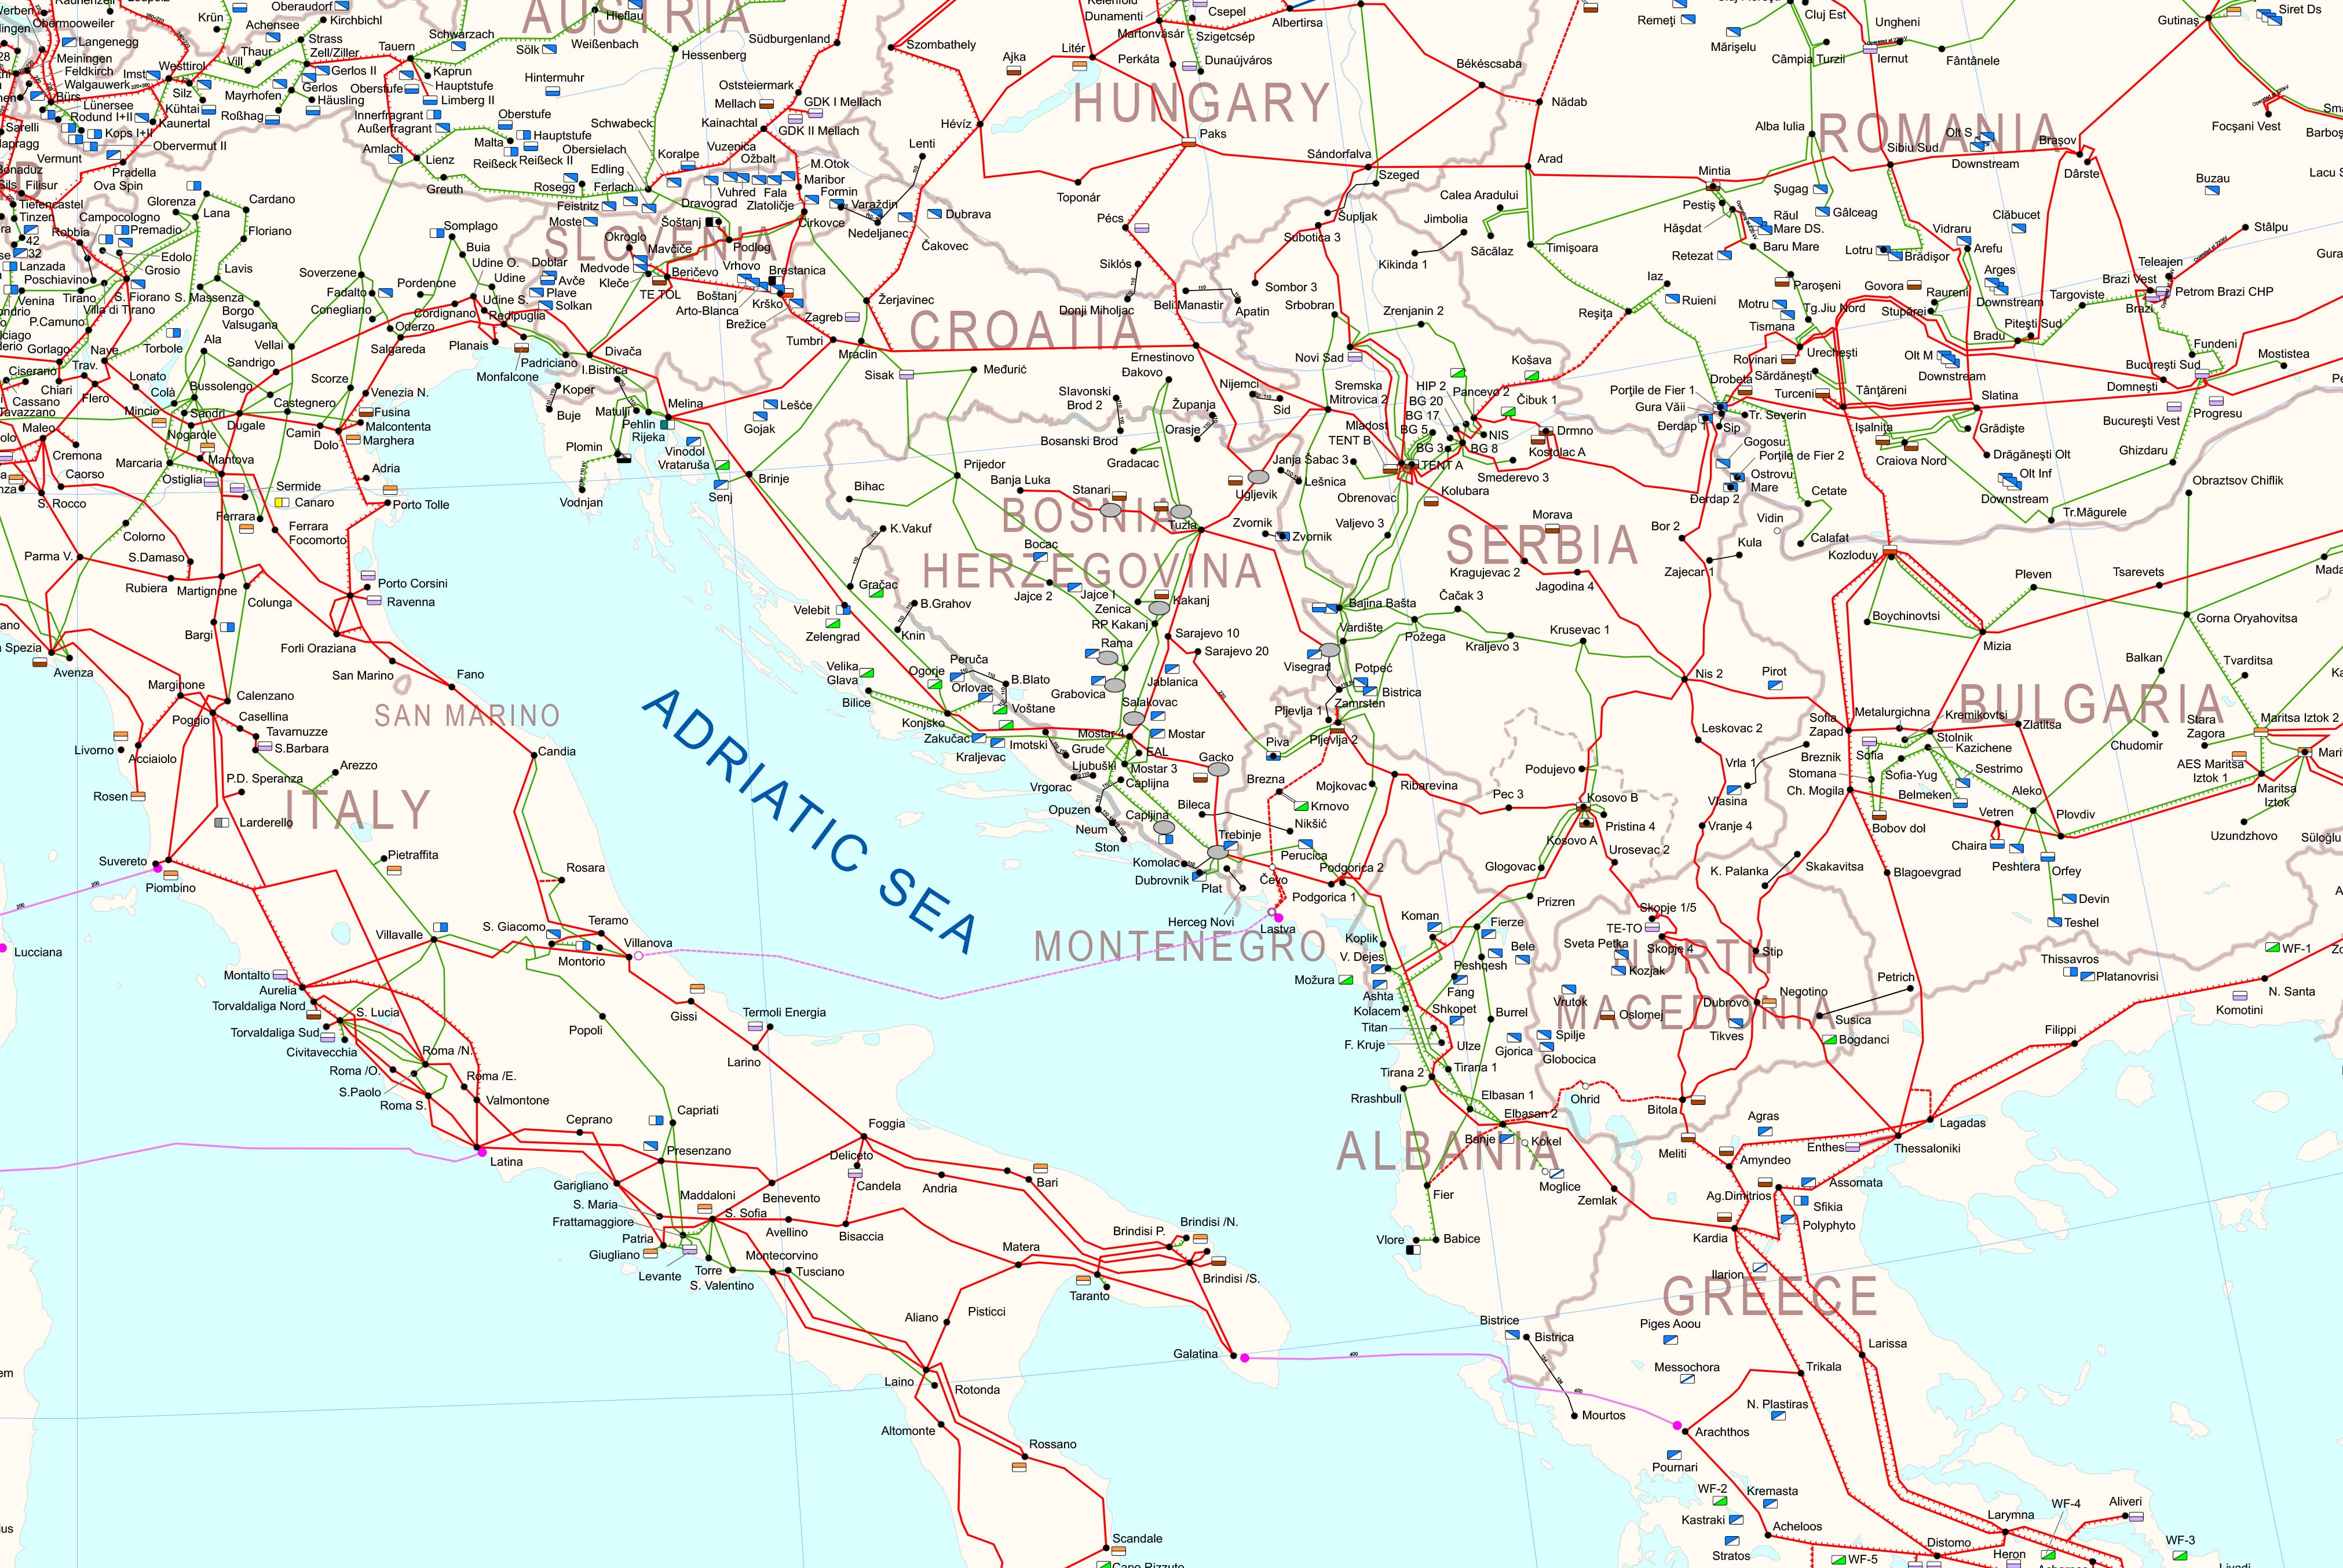
The electricity network

Slide 8
Agenda
1 | Fundamentals of the electricity and gas sectors in the Adriatic-Ionian region
2 | Current status of market development in the Adriatic-Ionian region
3 | Actions needed to integrate energy markets in the Adriatic-Ionian region

Slide 9
Status of market development in the region (gas)
Relevant questions to assess gaps with respect to the European “target model”
Is a Virtual Trading Point (VTP) established?
Integration of national markets under the EU framework (entry-exit model)
Is transmission capacity allocated in a transparent, effective and efficient manner?
Notes:
The Roadmap is not related to the implementation of the liberalization reform (third energy package) – clearly such reform would also encompass market integration.
The Roadmap is concerned only with the measures necessary to ensure integration under the entry-exit model. For instance, if a monopolist has access to transmission capacity, it is sufficient that is makes it available to suppliers downstream in a transparent manner (no hoarding…).

Slide 10
Status of market development in the region (electricity)
Relevant questions to assess gaps with respect to the European “target model”
Are national power exchanges established?
Day-ahead & Intraday?
Are exchanges part of the European coupled market?
SDAC – day-ahead
SIDC – intraday
Is the ancillary service market integrated with the European platforms for balancing?
TERRE – RR
MARI – mFRR
PICASSO – aFRR

Slide 11











Current status of market development in the Adriatic-Ionian region
not applicable
not applicable
Notes:
Electricity is evolving fastly, with many markets implementing national exchanges (incl. intraday expected in Serbia). The natural next step is the integration into SDAC and SIDC.
European platforms for balancing is a new thing, so far only Italy/Greece/Slovenia/Croatia are compliant (possibly waiting until derogation deadlines)
On gas, the situation is worse. Where VTPs are implemented, allocation is performed well and there are no issues. But in the ex-Yugoslavia region there is no gas market developed

Slide 12
Agenda
1 | Fundamentals of the electricity and gas sectors in the Adriatic-Ionian region
2 | Current status of market development in the Adriatic-Ionian region
3 | Actions needed to integrate energy markets in the Adriatic-Ionian region

Slide 13
The current EU market setting sets the pathway for market integration in the Adriatic-Ionian region
Electricity
Natural gas
European target model
Country-level exchanges
Market coupling in the day-ahead and intraday timeframes (SDAC and SIDC)
Implicit allocation ensures efficiency in the use of transmission capacity
European platform for balancing products (TERRE, MARI, PICASSO)
Efficiency in the spot markets ensures efficiency in the forward markets
Entry-exit model
Country-level virtual trading points (VTPs)
Entry-exit tariffs to transport gas → each VTP is a ‘hub’
Explicit allocation of transmission capacity
CAM regulation requires efficient allocation procedures, incl. anti-hoarding
For most IPs, a single “go-to” platform facilitates shipping at EU level (PRISMA)
Liquid forward markets indexed to spot prices
Most liquid market (TTF) act as price benchmark across EU
Planning of new infrastructures is coordinated at European level (TYNDP)
There is value for newly developed markets to maintain the same trading arrangements as the more liquid ones (e.g., trading venues, collateral management, product design, …)
Transposition of 3rd and 4th energy package into national law for Energy Community Parties

Slide 14
The implementation of the integration strategy is made easier by the constraints set at European level
Implementation of the integration strategy can be simpler for later comers
Electricity
Gas
National power exchanges are Nominated Electricity Market Operators (NEMOs) for market coupling purposes – but actual market operations can be “delegated” to another NEMO
Example
GME (Italy) runs operations for SEEPEX (Slovenia)
SEEPEX appointed as NEMO in 2022
Forward trading is largely centralized at EEX, so that products can be listed there to give immediate access to all EU traders
Intraday trading is centralized by Deutsche Börse, each national exchange acts as settlement agent towards other exchanges in case of cross-border transactions
“Merger” of entry-exit areas is an intuitive approach to market integration, but poses serious challenges due to the need for TSO-TSO coordination and inter-TSO compensation schemes
Effective and efficient integration is more likely to be achieved via the development of national VTPs + transmission capacity allocation procedures compatible with the CAM NC
Forward trading is largely centralized at EEX, so that products can be listed there to give immediate access to all EU traders
Implementation of EU codes and a sound regulatory framework are key

Slide 15
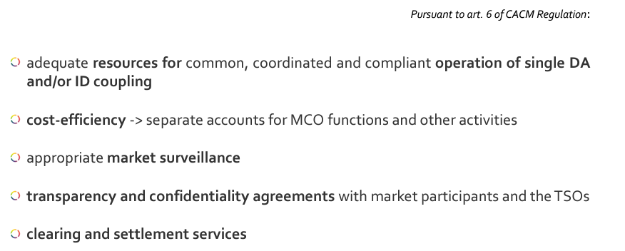
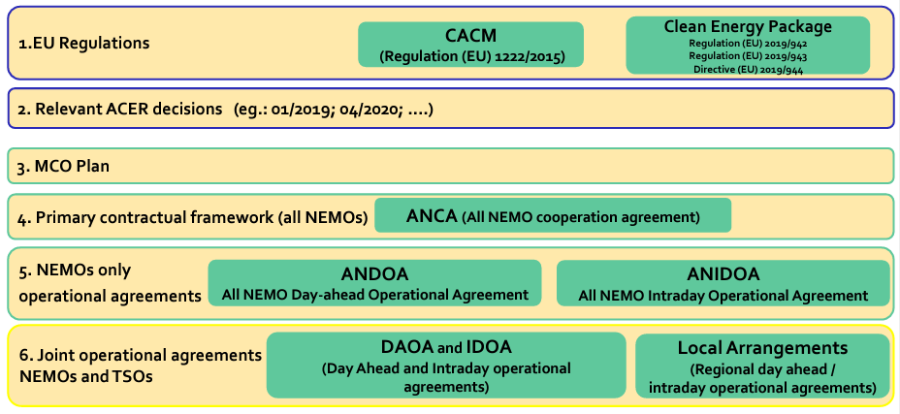
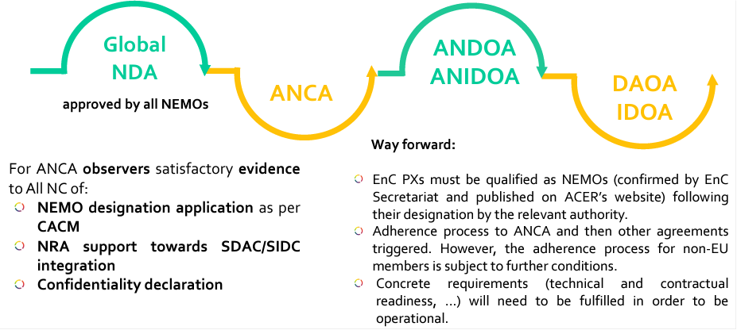
What is needed to become NEMO?
Source: All NEMO Committee, Energy Community WS 16 May 2023
Adherence to the entire legal framework
Successful application as per Art. 6 of CACM
A complex and lengthy process that requires compliance to the EU regulatory framework

Slide 16
Actions for market integration (electricity)
Country | Electricity
 | Market operator established? | Day-ahead market? | Intraday market? | Appointed as NEMO? | Competitive balancing market? | EU Platforms for balancing?
Italy | Yes | Yes | Yes | Yes | Yes | Yes
Greece | Yes | Yes | Yes | Yes | Yes | Yes
Slovenia | Yes | Yes | Yes | Yes | Yes | Yes
Croatia | Yes | Yes | Yes | Yes | Yes | Yes
Serbia | Yes | Yes | No | No | No | No
North Macedonia | Yes | No | No | No | Yes | No
Bosnia and Herzegovina | No | No | No | No | Yes | No
Montenegro | Yes | No | No | No | No | No
Albania | Yes | Yes | No | No | Yes | No
Establish national market
Appoint MO as NEMO
Join EU Platforms for balancing products

Slide 17
Actions for market integration (gas)
Country | Natural gas
 | VTP established? | Efficient allocation of capacity?
Italy | Yes | Yes
Greece | Yes | Yes
Slovenia | Yes | Yes
Croatia | Yes | Yes
Serbia | No | No
North Macedonia | No | No
Bosnia and Herzegovina | No | No
Montenegro | No gas market
Albania
Institute a national VTP
Implement effective and efficient capacity allocation and management procedures (CAM NC being the EU reference)

Slide 18

Q&A session

Slide 19

Contacts
Alberto Pototschnig
Director
DFC Economics
alberto.pototschnig@dfc-economics.com
Enrico Tesio
Principal
DFC Economics
enrico.tesio@dfc-economics.com
Guido Cervigni
Managing Director
DFC Economics
guido.cervigni@dfc-economics.com

Slide 20
Backup

Slide 21
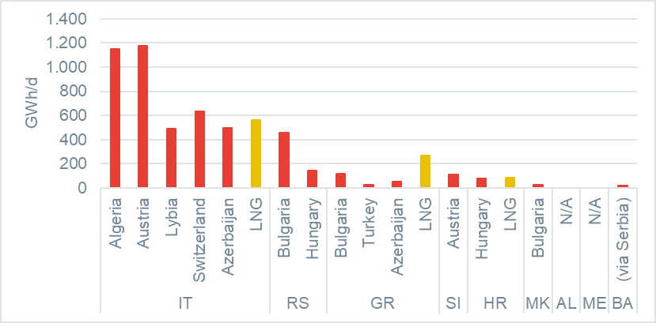
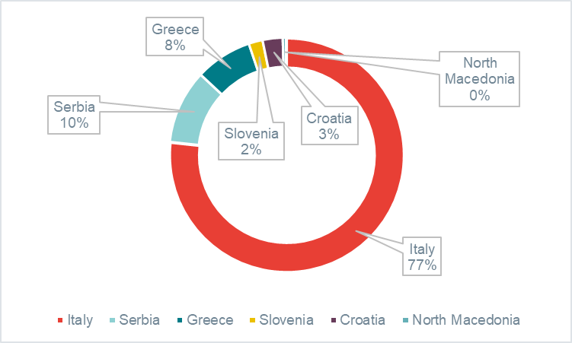
Ample gas import capacity into the region
Source: ENTSOG and GIE
Import capacity into the Adriatic-Ionian region
Import capacity by country
Total import capacity
Average consumption
5.875 GWh/d
1.688 GWh/d

Slide 22
Status of market development in the region (gas) / 2
% consumption | Country | VTP established? | Efficient transmission capacity allocation? | Liberalization of retail segment
87% | Italy (EUSAIR) | Yes | Yes | Yes
7% | Greece | Yes | Yes | Yes
5% | Croatia | Yes | Yes | Yes
4% | Serbia | No | No (hoarding at HU-RS border) | Yes (but switching very limited)
1% | Slovenia | Yes | Yes | Yes
0.4% | North Macedonia | No | No | Yes
0.4% | Bosnia and Herzegovina | No | No | Republika Srpska: Yes Fed. Bosnia and Herz.: No
0.0% | Montenegro | No gas market
0.1% | Albania | No gas market*
* Albania is currently supplied by national production

Slide 23
Status of market development in the region (electricity) / 2
Substantial developments are expected in 2023 in the Adriatic-Ionian region
% consumption | Country | National day-ahead market? | National intraday market? | Joined SDAC? | Joined SIDC? | European platforms for balancing?
57% | Italy | Yes | Yes | Yes | Yes | Yes
15% | Greece | Yes | Yes | Yes | Yes | Yes
10% | Serbia | Yes | No (expected June-2023) | No | No | No
5% | Croatia | Yes | Yes | Yes | Yes | Yes
4% | Slovenia | Yes | Yes | Yes | Yes | Yes
3% | Bosnia and Herzegovina | No | No | No | No | No
2% | North Macedonia | No (expected May-2023) | No | No | No | No
2% | Albania | Yes | No | No | No | No
1% | Montenegro | No (expected April-2023) | No | No | No | No
Notes:
Occhio che qui siamo “loose” nel concetto di “EU platforms”. TERRE solo l’Italia è Member, però Grecia Slovenia e Croazia sono dentro MARI e PICASSO (RR non è compulsory credo). Ciò detto, alcuni stati hanno delle deroghe per implementare oltre la deadline prevista dale EBGL (tipo: Grecia al 2024). Considero comunque questi paesi come “compliant”.

