Slide 1
DG REGIO activities to engage Youth
Presentation for MANY GENERATIONS - ONE FUTURE!
Nadine Lakhal

Slide 2
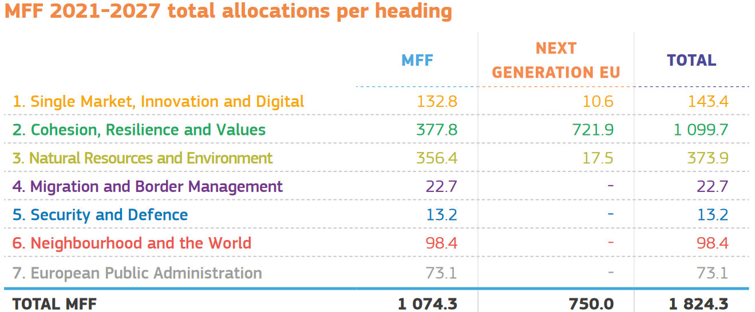
Cohesion Policy is the EU’s main investment policy
Targets all regions and cities in the European Union in order to support job creation, business competitiveness, economic growth, sustainable development, and improve citizens’ quality of life.
Macro-regional strategies (EUSBSR, EUSDR, EUSAIR, EUSALP)
Interreg programmes
cooperation between Member States and between Member States and non-EU countries (support to enlargement)
cross-border, transnational, interregional programmes

Slide 3

Youth Manifesto
Youth Manifesto for Young People
by Young People to shape European
Cooperation Policy
Including Interreg Managing Authorities,
project beneficiaries and Macro
Regional Strategies
Express five areas of concerns:
1) education and training opportunities; 2) employment and job market;
3) digitalisation; 4) climate change; 5) citizens' engagement.
LinkedIN group: Youth & Interreg – Manifesto core group

Slide 4
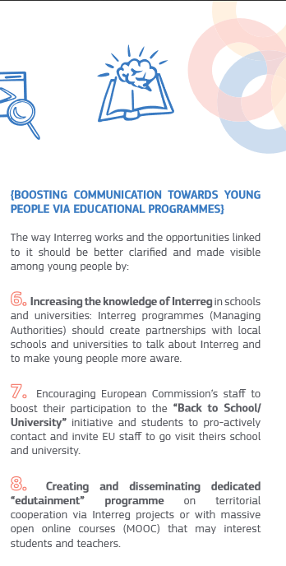
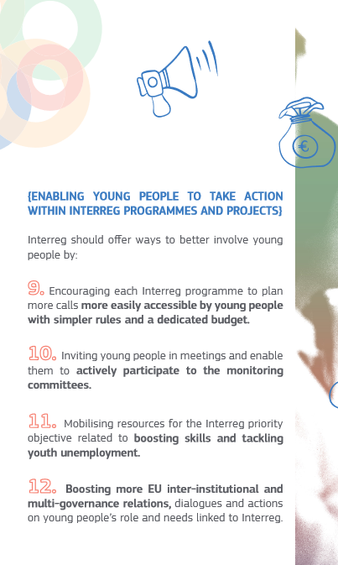
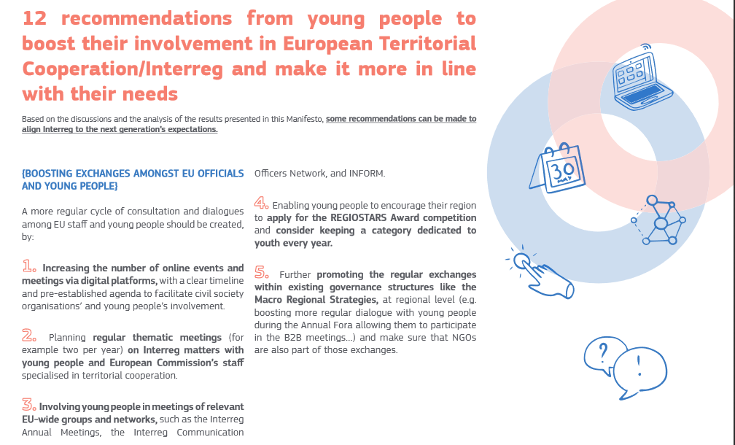
Youth Manifesto

Slide 5



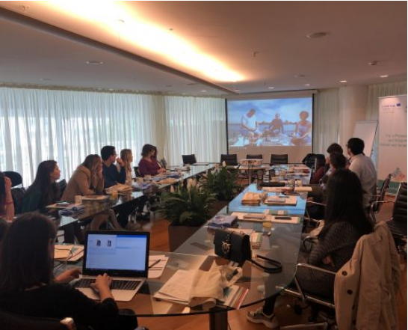





Slide 6

Interreg Volunteer Youth (IVY
part of the broader European Solidarity Corps Initiative launched by the European Commission in 2016
For young people aged 18-30 to volunteer in cross-border, transnational or interregional programmes and related projects.
Aim: to involve young volunteers to support, promote and report the concrete achievements of Interreg, to enhance and gain skills that they can employ in their future experiences.
promote cooperation across borders and related values such as solidarity.
IVY experience varies and range from health to environment, from social inclusion to technology and innovation, communication etc.

Slide 7

Youth4Regions – European Week of Regions and Cities (11-14 October 2021)

Slide 8
Trainings on journalism and EU regional policy
Working side by side with renowned journalists during the EU Regions’ Week
Take part as a journalist in European Commission press trips to Member States
Visits of EU affairs media headquarters and EU institutions
Apply until 12 July 2021, 17:00 CET (Brussels time)
https://ec.europa.eu/regional_policy/en/policy/communication/youth4regions/

Slide 9
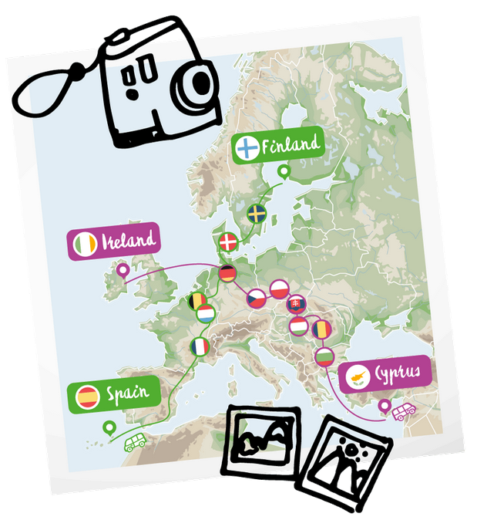
Road Trip Project
young travellers embarking on a van for a journey across Europe
meet locals and explore a variety of EU-supported projects and activities of Cohesion Policy
share videos, photos and blog posts on social media platforms, to trigger a Europe-wide conversation among their peers.
In 2018: Mediterranean route, Atlantic route, Danube
In 2019: Aland Island, Canary Islands, Ireland to Cyprus
In 2020: the Green Trip (BE, DE, EL, LT, PT)

Slide 10

Blue Book Traineeship
Twice a year, 5-month paid internships in EU Directorates, Institutions and agencies
Requirements: University degree or equivalent, of at least 3 years of study, corresponding to a complete cycle (Bachelor's) & language proof
Next traineeship from March to July 2022
Open to EU Memeber States and for enlargement countries of the Western Balkans
Apply here: https://ec.europa.eu/stages/home_en
Alternative: Stagiare Atypique

Slide 11

Conference on the Future of Europe
is a citizen-led series of debates and discussions that will enable people from across Europe to share their ideas and help shape our common future
inaugural hybrid event on 9 May 2021 on Europe Day
Platform launched to forward your ideas on 10 priorities, participate in events to share them and organise events https://futureu.europa.eu/

Slide 12



Thank you
Follow us on
@RegioInterreg
@EURegionInterreg
Youth & Interreg – Manifesto core group

