Slide 1
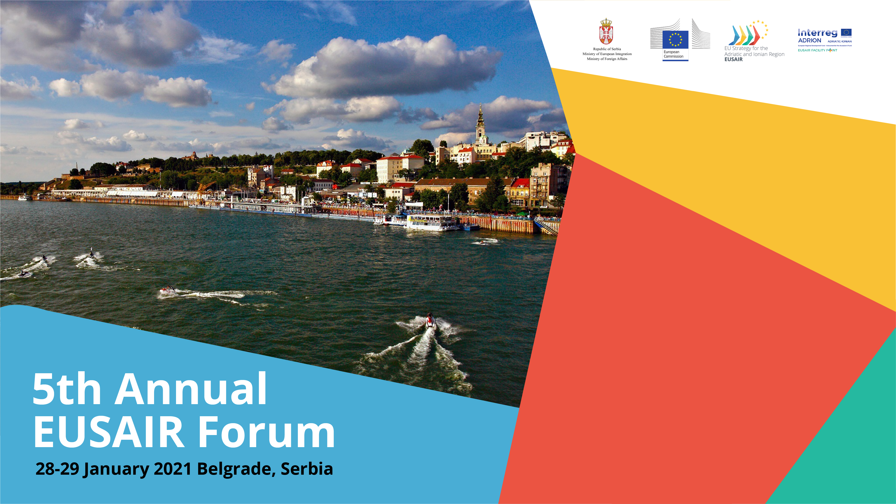
SUBTEXT

Slide 2
Presentation Contents
Strategic Goals
Structure of the Primary Consumption
Projection of Final Energy Consumption
Transport Gas System
Balkan Stream
Planed Interconections
Ministry of Mining and Energy, Belgrade, 28-29 January 2021

Slide 3
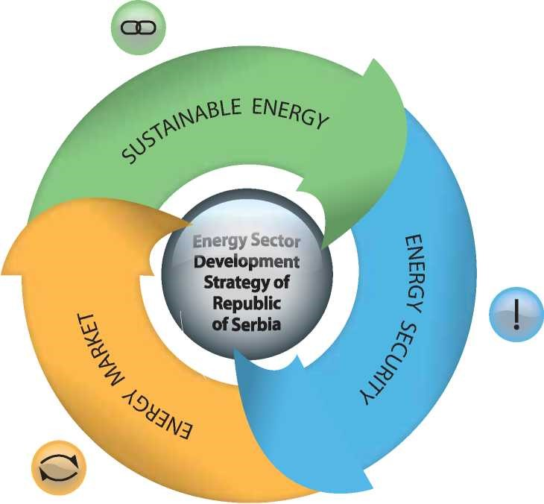
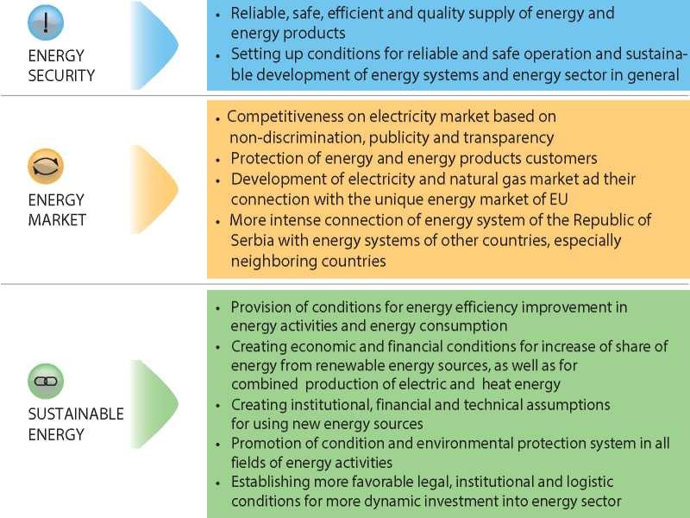
Republic of Serbia - Strategic Goals
Ministry of Mining and Energy, Belgrade, 28-29 January 2021

Slide 4
Republic of Serbia - Structure of the Primary Consumption
Import dependency
35%
Gas import dependency
84%
Ministry of Mining and Energy, Belgrade, 28-29 January 2021

Slide 5
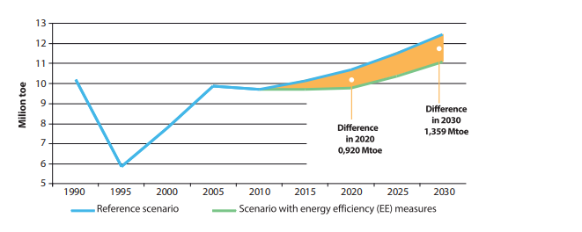
Republic of Serbia - Projection of Final Energy Consumption
Ministry of Mining and Energy, Belgrade, 28-29 January 2021

Slide 6
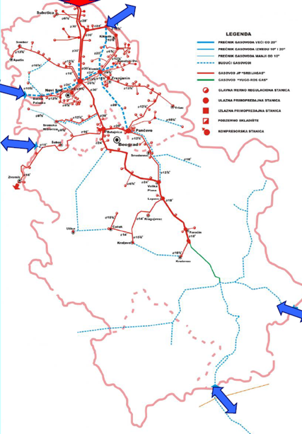
Republic of Serbia -Transport Gas System
Import dependency - need to raise the level of security of supply
Realzation of new pipeline projects (Balkan Stream);
Realization of new interconection projects (Bulgaria, Romania, Croatia, Macedonia, Bosna and Herzegovina, Montenegro )
Capacitiy expansion of the Gas storage facilities Banatski dvor
Ministry of Mining and Energy, Belgrade, 28-29 January 2021

Slide 7
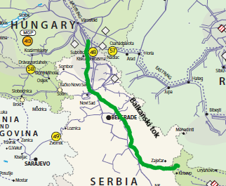
Republic of Serbia – Balkan Stream
Increase gas security of supply
Significant for economic development and social stability
Lenght: 403 km
Annual capacity – about 13 billion m3
Ministry of Mining and Energy, Belgrade, 28-29 January 2021

Slide 8
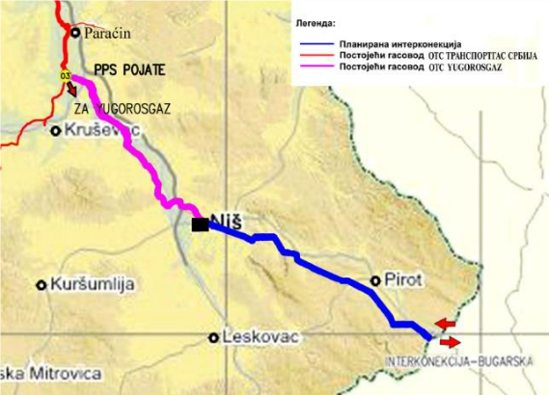
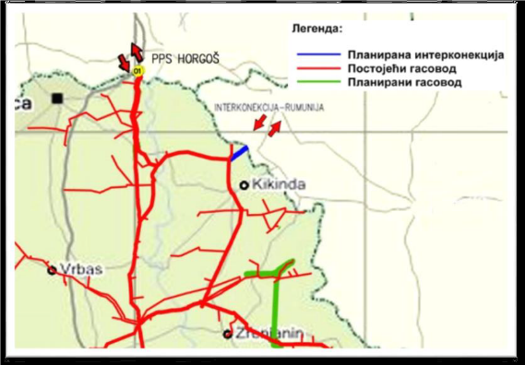
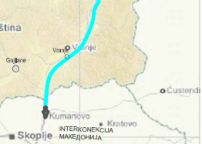
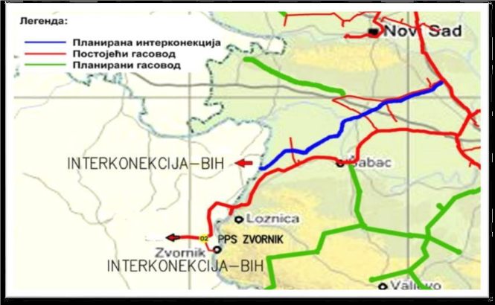
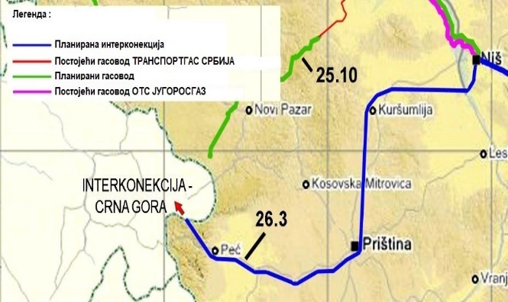
Republic of Srbia - Planed Interconections
Serbia - Bulgaria
Serbia - Romania
Serbia – North Macedonia
Serbia – Bosnia and Herzegovina
Serbia – Montenegro
Ministry of Mining and Energy, Belgrade, 28-29 January 2021

Slide 9
Thank You! Contact: Ministry of Mining and Energy kabinet@mre.gov.rs
Ministry of Mining and Energy, Belgrade, 28-29 January 2021

