Slide 1
The role of a “natural gas transporter” in the energy transition
Gerasimos Avlonitis
Market Development Manager, Member of the BoD of the Hellenic Energy Exchange
5th EUSAIR Forum | 28-29.01.2021

Slide 2
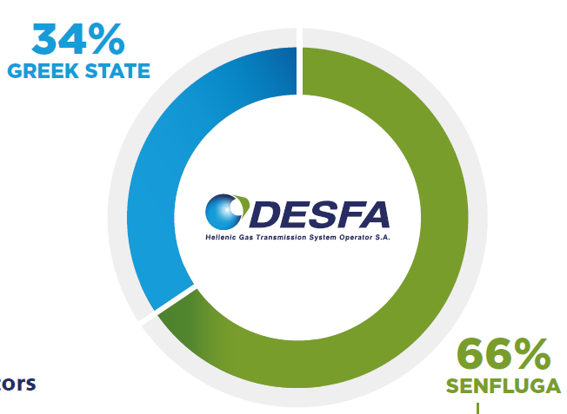

The Hellenic Gas Transmission System Operator (DESFA)
Established in March 2007, DESFA owns and operates the Greek National Natural Gas System (NNGS), which consists of the National Natural Gas Transmission System & the LNG Terminal in the islet of Revithoussa.
After the completion of a privatization process in the 20th of December 2018, DESFA was certified as an Ownership Unbundled Operator under the 3rd EU Energy Package
DESFA operates, maintains and develops the National Natural Gas System in a safe, reliable and economically efficient way and offers (a) regulated Third Party Access services in a transparent and non-discriminatory way and (b) a range of non-regulated services to a number of national and international clients
DESFA is established
DESFA certified as an Independent Transmission Operator under the 3rd EU Energy Package
Privatization process is completed
DESFA is certified as Ownership Unbundled Operator
September 2014
December 2018
March 2007
December 2018

Slide 3
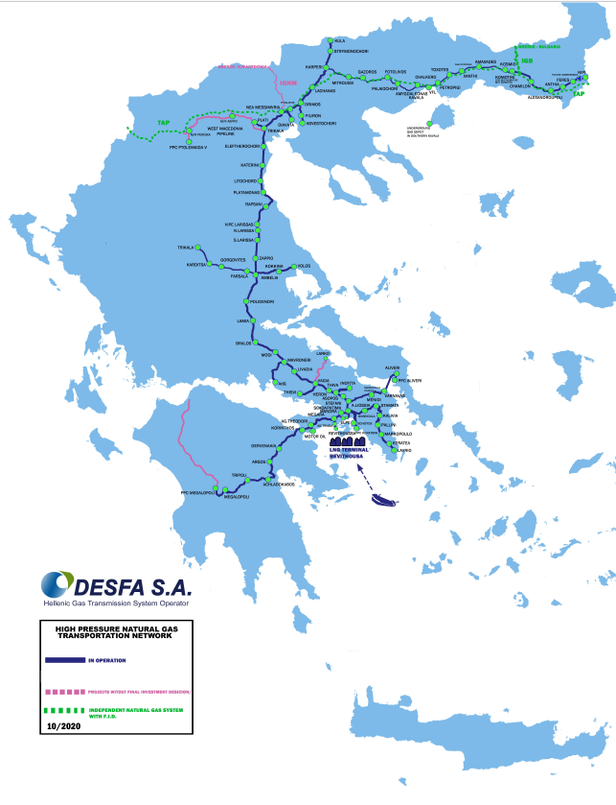
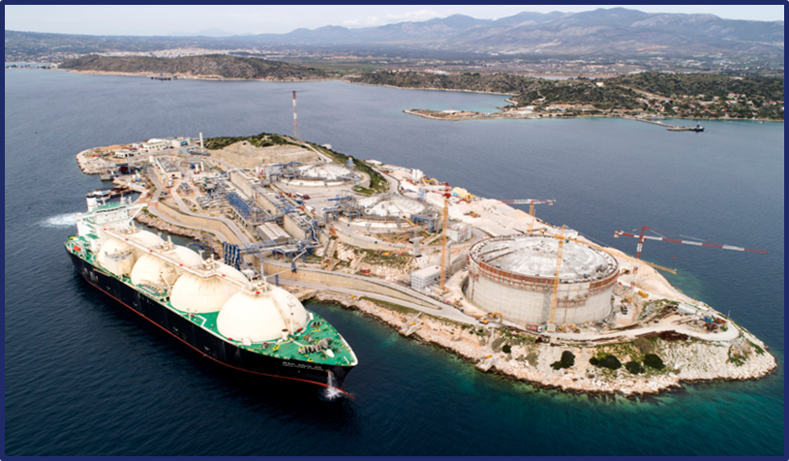
DESFA at a glance
IP KULATA (BG)/SIDIROKASTRO (GR)
470 people
Personnel
KIPI (GR/TR)
1.466 km
High-pressure pipelines
1
LNG storage and regasification terminal
IP NEA MESSIMVRIA (DESFA/TAP)
€761M
Regulated Asset Base
3
Interconnections
53
Metering & Regulation Stations
2
Dispatch
Centres
6
Operation & Maintenance Centres
AGIA TRIADA
1
Compressor station
22
Exit points connected to distr. systems
€217M
2019 Regulated Revenues

Slide 4
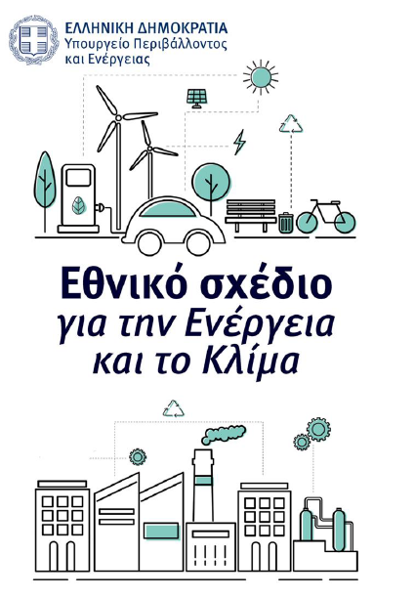
Greek NECP for year 2030, December 2019
Fully aligned with European targets (more ambitious targets for RES)
Estimated investments in key areas of NECP: 43,8 bil €
Energy efficiency: priority no 1
Considers decreased final energy consumption compared to year 2017 (high ambition target!)
GHG emission reduction in alignment with EU targets
RES share: 35% in gross final energy consumption (currently is almost 18%)
65% in domestic electricity production,
19% in transportation
Electric interconnection of all islands by the end of 2029
Promote the country as a regional energy hub
Enhance electricity and gas interconnection with neighboring countries
Promotion of LNG as maritime fuel
Lignite phase out by 2028
Projects where DESFA can directly contribute

Slide 5
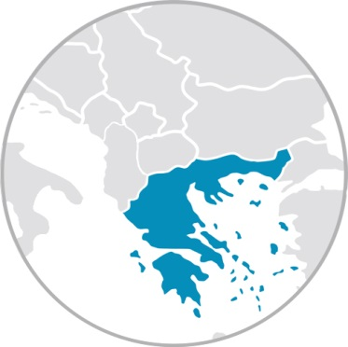
Towards a physical and commercial hub
Action points:
Increase interconnection capacity
Increase interoperability
Increase system capacity and flexibility
Develop trading infrastructure/gas exchange
Allow for new gas uses (Small Scale LNG, off-grid solutions)
DESFA draft TYNDP amounts to 500 mln over the next 5 years:
HP pipeline to West Macedonia
Investment: 110 M€
HP pipeline to Patra Investment: 85 M€
Interconnector Greece – N. Macedonia
Investment: 51.4 M€
SSLNG & Truck loading
SSLNG Jetty: 20.4M€
Truck Loading Pilot Station: 6,5M€
Hellenic Energy Exchange/establishment of a gas exchenge:
Shareholders: DESFA 7%
DESFA
1
2
3
Bulgaria
4
IGB
5
N. Macedonia
7
I. Greece – N.Macedonia
3
Albania
Alexandroupolis FSRU:
Investment: €350 - 370 M
Interconnector Greece – Bulgaria (IGB):
Investment: € 250 M
Trans Adriatic Pipeline, TAP: Completed
Investment: €4,500 M
Dioryga Gas FSRU:
Investment: €150-200 Μ
UGS South Kavala:
Expression of interest to participate in the privatization tender
8
6
Other Developers
TAP
6
0
Italy
FSRU
Alexandroupolis
W. Macedonia
W. Macedonia
1
7
8
9
5
2
9
W. Greece
4
4
2
W. Greece
Existing lines
Projected lines
Gas Sources
Potential Gas Sources
Tender
0
LNG

Slide 6
Role for a “natural gas transporter” in the energy transition
A small “case study”
West Macedonia is located in the Northern part of Greece
West Macedonia hosts the main lignite (coal) power plants in Greece, which also supply three District Heating networks
In the framework of the Greek Government’s delignitisation plan, all lignite power plants will be phased out until 2023 (apart form a newly built one) - the operation of the District Heating networks is not ensured after this date
The Greek government has prepared a “Just Transition Development Plan” for the area of West Macedonia. Another consideration for the area is the creation of a “hydrogen valley” in the area (White Dragon project)
DESFA’s proposal: A hydrogen-ready, high pressure pipeline from the National Transmission System towards West Macedonia This pipeline will:
Supply the District Heating network as well as the main cities of the region and (potentially) power generation projects
Connect the NNGTS to an area where hydrogen production is planned
DESFA has included the project in its last TYDP, awaiting regulatory approval
Nea Messimvria – IP with TAP
West
Macedonia

Slide 7
Thank you for your attention!

