Slide 1
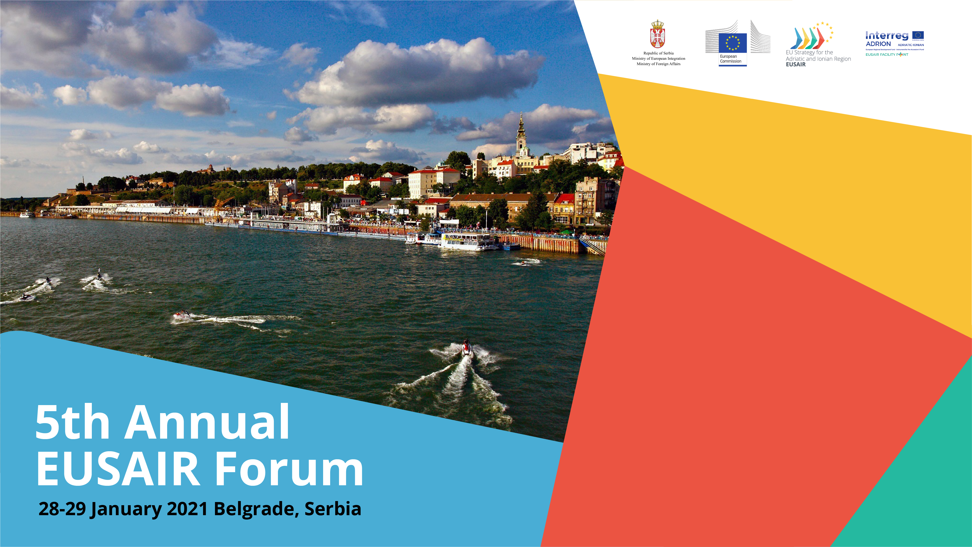
SUBTEXT

Slide 2
Embedding EUSAIR priorities in post 2020:
The Italian contribution
Dr. Massimo Gerli
Director General
Presidency of the Council of Ministers
Department of Cohesion Policy

Slide 3
EUSAIR Embedding: the Italian contribution
«Non paper» on ETC in 2021-2027 (September 2019): Italy committed to strengthen cooperation among programmes of the Adriatic and Ionian area, considering EUSAIR priorities as backbone
Two main activities:
  Dialogue with key implementers of Mainstream funds (24 regional MAs for EUSAIR);
  WG with Italian MAs of ETC programmes.

Slide 4
1) Dialogue with key implementers of Mainstream funds
Presentation of EUSAIR priorities for embedding during the partnership meeting for the preparation of the Partnership Agreement (sept-nov 2019)
Reference to EUSAIR in the Italian Partnership Agreement
A specific project will soon be launched:
  platform of dialogue with mainstream key implementers;
  support to capitalisation activities, especially in terms of integration and transferability of good practices; etc.

Slide 5
2) Working group of Italian ETC MAs in the Adriatic and Ionian area (1/3)
PROGRAMMES | COUNTRY | MANAGING AUTHORITY (2014-2020)
TN ADRION | ITALY | EMILIA ROMAGNA REGION
CBC
ITALY – CROAZIA | ITALY | VENETO REGION
ITALY – SLOVENIA | ITALY | FRIULI VENEZIA GIULIA REGION
CBC IPA
ITALY -ALBANIA – MONTENEGRO | ITALY | PUGLIA REGION

Slide 6
2) Working group of Italian ETC MAs in the Adriatic and Ionian area (2/3)
Objectives:
To develop a common understanding of the contribution of ETC programmes in relation to the EUSAIR strategy;
To strengthen collaboration between programmes and EUSAIR governance actors;
To identify strategic themes for testing the coordination of activities on individual Programmes;
To ensure joint capitalization of the results on strategic themes;
Etc.

Slide 7
3) Working group of Italian ETC MAs in the Adriatic and Ionian area (3/3)
Examples of activities carried out:
October 2020, a first event (with EUSAIR FP – Marche Region) involving EUSAIR’s pillars coordinators and the Italian MAs of the ETC programmes of the Adriatic-Ionian area
Setting up of a database of projects (with EUSAIR FP – Marche Region) most in line with EUSAIR. It is under construction and it will be soon available on the stakeholder platform.
Possibility to share our experience or enlarge the participation to the WG to other interested ETC programmes in the EUSAIR area.

