Slide 1
EUSAIR TSG2 (TRANSPORT) and TSG4 (TOURISM)
Back-to-back with EUSDR PA3
Cycling Tourism and Cultural Routes
Workshop
Transdanube Travel Stories
2 October 2020

Slide 2

How can we support sustainable tourism in the Danube region?
Cultural Routes
Employ innovative (more holistic) promotion approaches
Sustainable Mobility
Integrate sustainable mobility management measures and tools
Green Transnational Travel Products

Slide 3
Cultural and natural heritage sites
Roman
Wine
Religion
Architecture

Slide 4
Stories linking destinations to a trail
Roman
Wine
Religion
Architecture

Slide 5
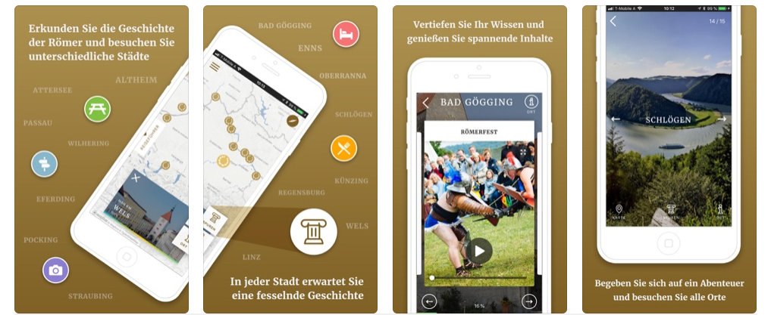
Experiencing the story = Danube Narrative

Slide 6

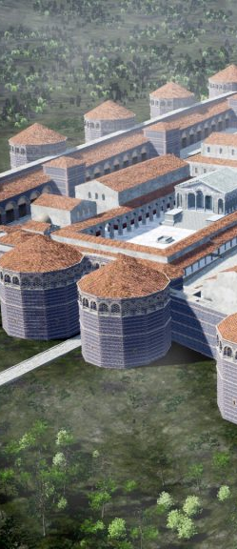
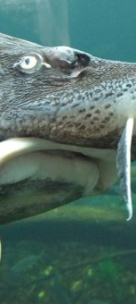
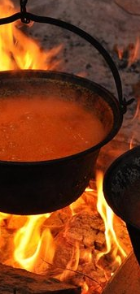
Experiencing the story = Danube Narrative

Slide 7
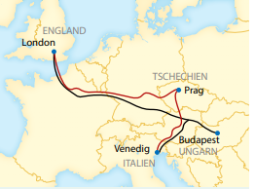

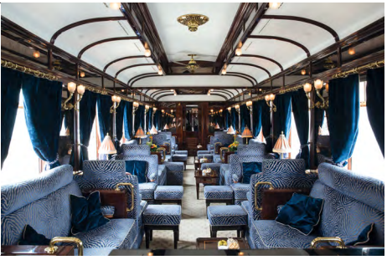
Experiencing the story = Danube Narrative

Slide 8
How can we implement the narratives?
Set-up of Product Clubs
establish an informal coalition of local service providers aligning their services with the stories at destination level and along the trail
Winter School for Guides
tell the stories within the wider context of the trail

Slide 9
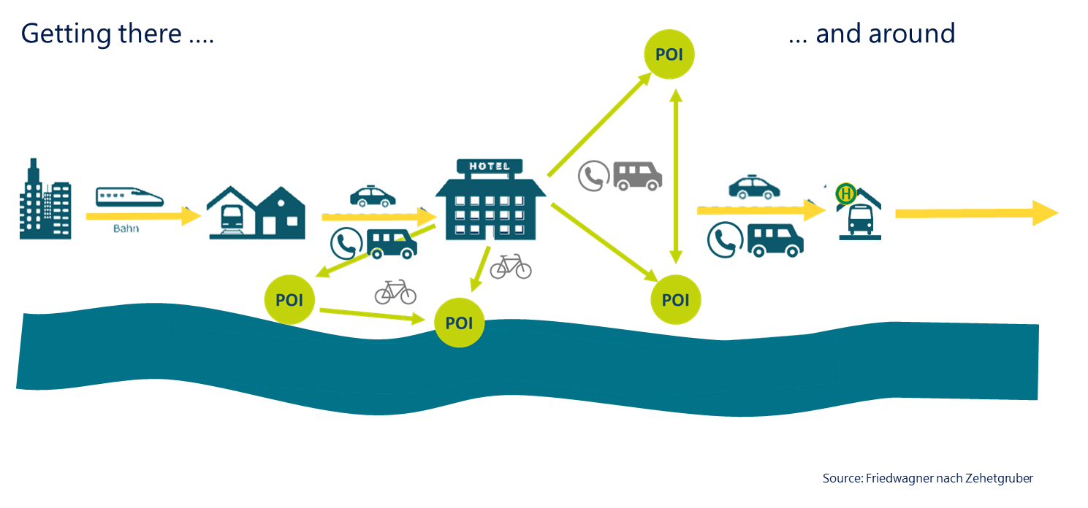
Travelling the trail sustainably

Slide 10
How can we implement mobility management?
Mobility Manager
inform costumers about alternative travelling to car-use
Mobility Plan
collection of information on sustainable mobility, time tables, bike rental, barrier-free travel etc.
Mobility Centre
operating unit at destination level

Slide 11
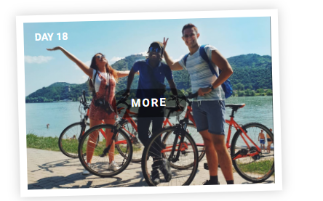
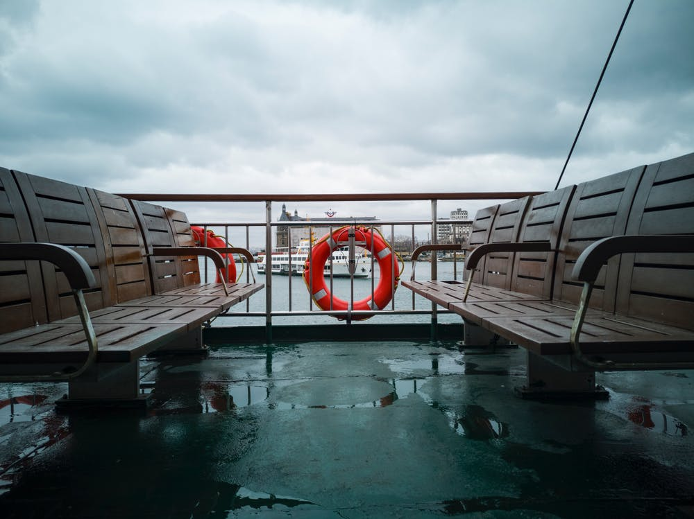
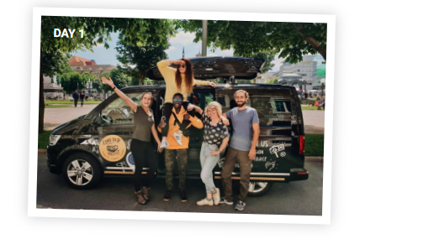

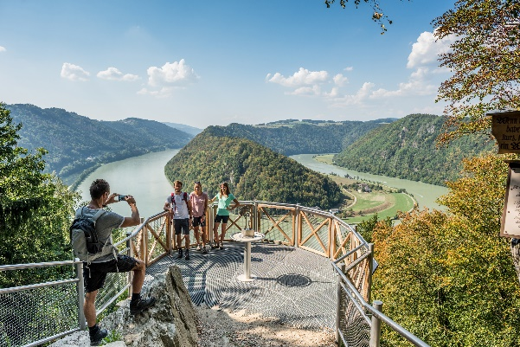
Danube Travel Challenge

Slide 12
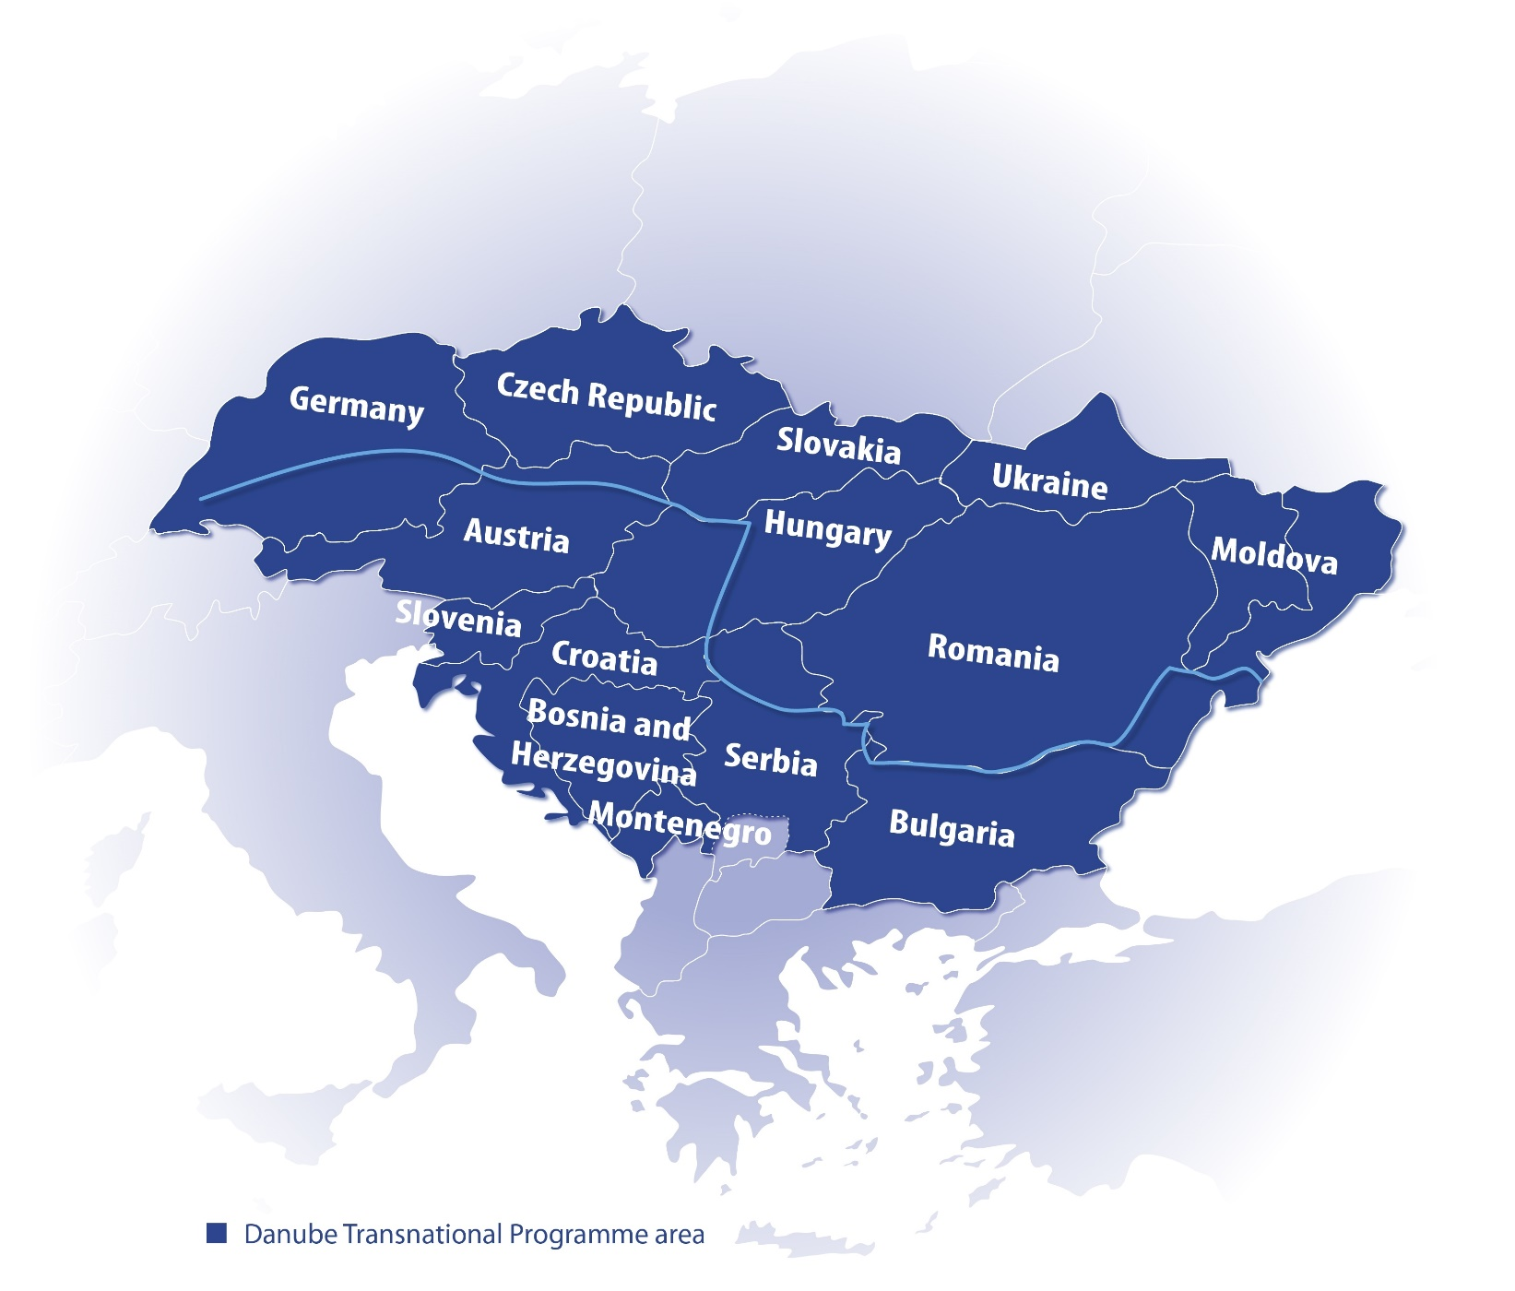
Partnership of DTP project
Environment Agency
Austria
Danube Office
Ulm/Neu Ulm
Danube Parks
Network
Westpannon
Oradea Municipality
Linz Tourism
Working Community of
Upper Austian Danube Region
Institute for Culture,
Tourism and Sport
Croatian Association for
Tourism and Rural Development
Danube Competence Center

Slide 13






Thank you for your attention!
Agnes Kurzweil
Environment Agency Austria| Lead Partner
agnes.kurzweil@umweltbundesamt.at
+43 1 313 04-55 56
Christina Narval
Verracon| Transnational Coordinator
c.narval@verracon.at
+43 680 40 66 66 1

