Slide 1

PANORAMED
Innovation
ADRIATIC-IONAIN REGION (EUSAIR) S3 NETWORK
A PUSH FOR STRENGTHENED INTERNATIONALISATION:
First EUSAIR Smart Specialization Strategies Governance representatives meeting
23 & 24 September 2020
Rudi Panjtar
prof. dr. Borut Likar

Slide 2





One territorial priority axis
PRIORITY AXIS 1:
Promoting Mediterranean innovation capacities to develop smart and sustainable growth
PRIORITY AXIS 2:
Fostering low carbon strategies and E.E. in specific MED territories: cities, islands and remote areas
PRIORITY AXIS 3:
Protecting and promoting Mediterranean natural and cultural resources
Areas
PRIORITY AXIS 4:
A shared Mediterranean Sea
1
2
3
4
71,7M€ ERDF
2,9 M€ IPA
44,8 M€ ERDF
1,8 M€ IPA
76,2 M€ ERDF
3,2 M€ IPA
17,9M€ ERDF
0,7 M€ IPA
Three thematic priority axes

Slide 3
Three typologies of projects
Modular projects
Horizontal projects
Platform projects
In thematic axes 1,2,3
In Governance axis 4
Notes:
Only modular projects and horizontal projects will be presented here, platform projects will be developed in a later stage in the implementation period.

Slide 4
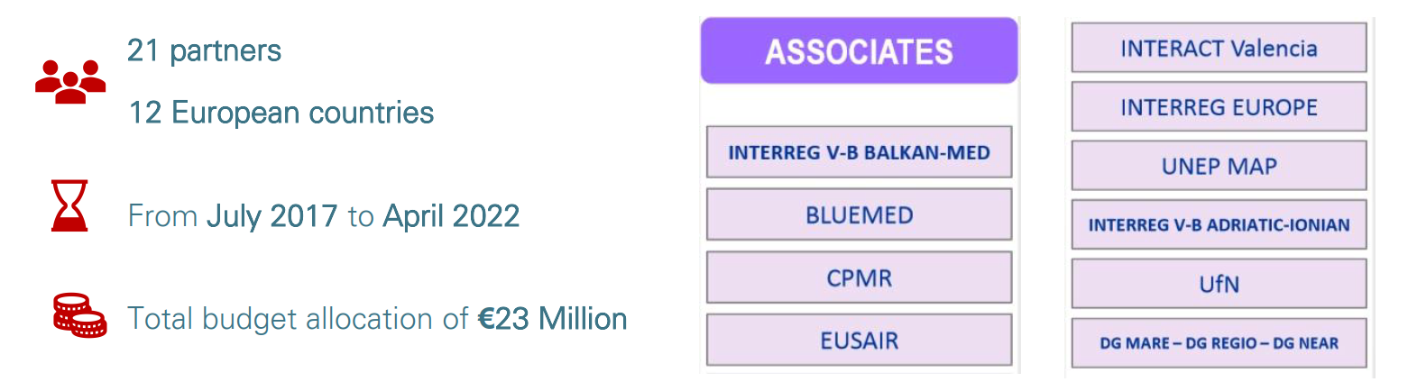
Panoramed Facts
PANORAMED is a governance platform that supports the process of strengthening and developing multilateral cooperation frameworks in the Mediterranean region for joint responses to common challenges and opportunities with 3 strategic themes:
Coastal & maritime sustainable tourism
Maritime surveillance
Innovation
PANORAMED establishes a permanent dialogue among national and regional public authorities and stakeholders for the definition of shared approaches, policies and strategic projects. It also allows the set-up of transnational thematic working groups involving strategic key actors to identify shared policy approaches and strategic top-down projects.
They constantly seek synergies and complementarities with the main institutions and
initiatives active in the Mediterranean.

Slide 5
Strategic Theme Innovation
The question for the WP Innovation was:
How can public Administrations promote the application of blue biotechnologies to tackle MED complex societal challenges in innovative ways that are effective (have impact) and sustainable?
Our answers were:
We need systemic innovations beyond the technological dimension focused on socio-technical system transformation.
We need systemic approaches to reduce trade-offs, to build synergies across stakeholders and economic activities, while maximising shared value in an equitable manner without compromising the sustainability of vital ecosystems (contributing to socio-technical system transformation).
We need governance models for responsible research and innovation that integrate public engagement, gender equality, science education, open access/science and ethics to tackle societal challenges (SDGs) in more effective ways.

Slide 6
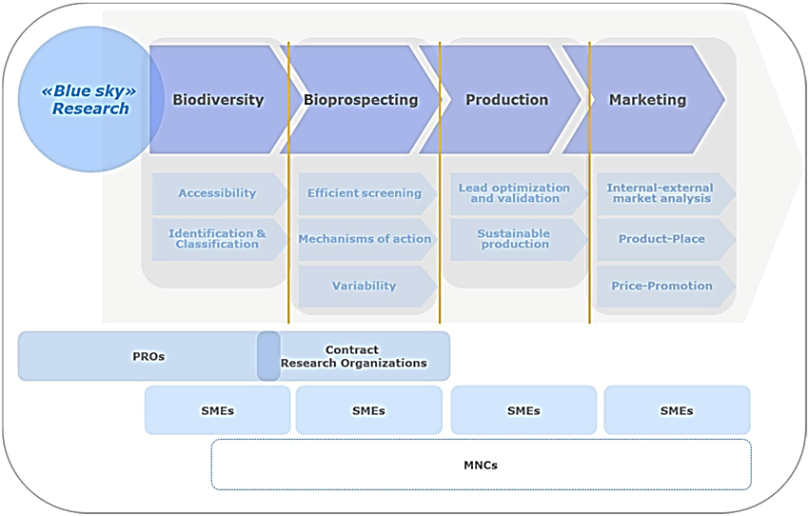
Adressing whole Blue Biotechnology Value Chain
INNOVATION CLUSTERS
Small and medium enterprises play a significant role - they bridge the gap between public research and commercialization of products and services, mainly realized by multinational companies.
Notes:
Picture shows the value chain for blue biotechnology. A strong international debate is, in fact, ongoing on what are the activities that public research centers have to develop and what are in the “private” domain. It is mainly a science politics' choice.
It is a good field for public – private partnerships in a form of innovation clusters which can offer more market oriented approach then scientific/academic domain and in the same time get benefit from sourcing public founds for costly research investments.
On the other hand, hightech SME‘s can be involved in value chain of multinational companies
PRO – public research organisations
MNCs- Multinational companies

Slide 7
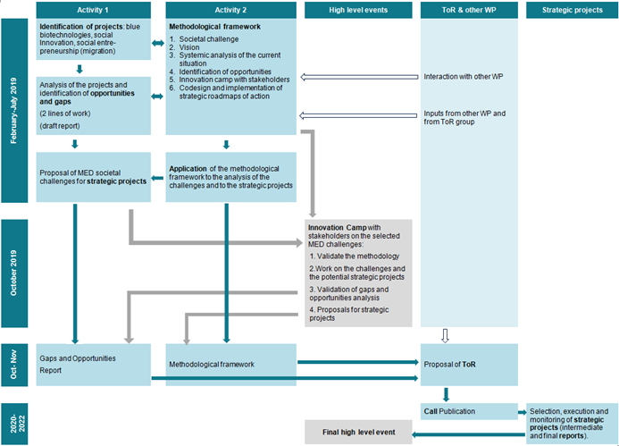
Overall view WP Innovation
7

Slide 8
Conceptual Framework
Sustainable
and systemic
change
Participative governance
Supporting technology (blue biotechnology…)
Business models addressing societal challenges
Blue bioeconomy opportunities
Societal value:
- social value
- environmental value
- economic value
Notes:
The challenges of blue economy in the Mediterranean region (MED) are transnational, multi-sectoral and complex.
Complex social challenges (emergent and persistent ones) arise and persist because of a complex combination of actions and omissions of the stakeholders in all sectors.

Slide 9




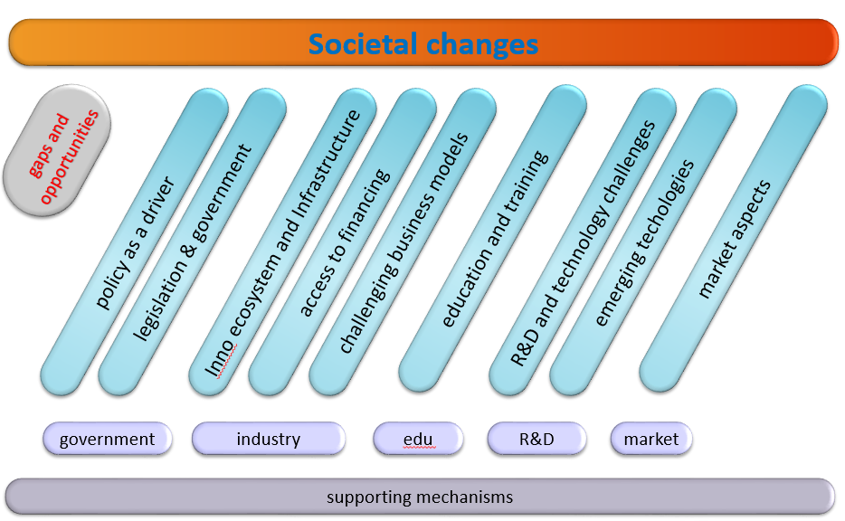
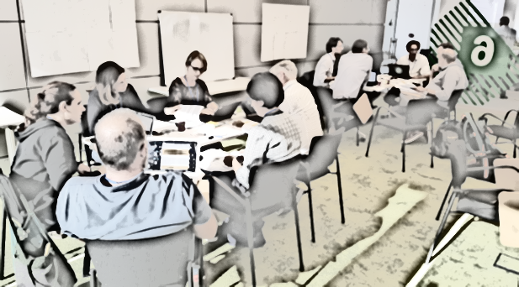

Ljubljana
Brusells
experts
experts
Experts‘ Gaps
analysis
Relevant EU documents
Experts‘ projects
identified
Relevant EU/national programmes + projects
Inputs
Strategic project design
InnoCamp
Terms of Reference
Policy Recommendations
Gaps & opportunities
Develop
Verify
Experts/Partners
Inno Camp - Barcelona
Notes:
Experts:
Profile 1: R&I experts in blue biotechnologies
Profile 2: Experts in clusters and companies
Profile 3: Experts in labs and open innovation + policy makers

Slide 10
Strategic projects ToR
Main objectives of the strategic projects are:
Enhancement of the capacity to design and implement multilevel innovation policies and action for the blue bioeconomy.
Strengthening of the blue bioeconomy innovation ecosystem.
Two strategic project identified:
1: focus on promoting the use of blue biotechnologies to address the SDGs in the MED and on promoting new value chains and business opportunities.
2: focus on promoting the articulation of the collaboration of the quadruple helix actors to address the SDGs in the MED and on improving the governance of innovation policies to increase the coherence among multilevel programs, strategies and initiatives.

Slide 11
Strategic Projects ToR main Objectives
Strategic project 1:
Coordinated capacity building in blue bioeconomy subfields.
Triggering interregional innovation along blue-biotechnology value chains.
Strategic project 2
The enhancement of the capacity to design and implement multilevel innovation policies and action for the blue bioeconomy.
The strengthening of the blue bioeconomy innovation ecosystem

Slide 12
Strategic projects ToR
The two new projects – “B-Blue” and “BLUE BIO MED” – both involve a total of 21 partner organizations from nine European Mediterranean countries and a financial investment of three million Euros, of which 2.9 in ERDF and 80k in IPA funds.
These partnerships will work to promote the smart specialization of the Mediterranean area in the blue bio economy.
More details on www.panoramed.eu

Slide 13
Interesting „take-aways“ ?
Gaps & Opportunity Report
Participatory Governance for the Development of the Blue Bioeconomy in the Mediterranean Region
How clusters can contribute to the social and environmental challenges through the creation of shared value
Key Policy Paper on Innovation

Slide 14
What comes next ?
Key policy paper on innovation in Mediterranean
( already accepted by partners and JS)
Strategic projects follow – up
Thematic working groups – MED strategic talks
(preparing for the next EU perspective?)

Slide 15
Tatiana Fernandez
t.fernandez@gencat.cat
Rudi Panjtar
rudi.panjtar@ijs.si
Borut Likar
borut.likar1@guest.arnes.si

